Slide 1


Blended learning course
Promoting Inclusive Employment in the GLAM Sector through Open Innovation
Module 3: COMMUNICATION & COOPERATION
Session 1
Developed by: VINCO
„Funded by the European Union. Views and opinions expressed are however those of the author(s) only and do not necessarily reflect those of the European Union or OeAD-GmbH. Neither the European Union nor the granting authority can be held responsible for them.“ Project No: 2022-1-AT01-KA220-ADU-00008513

Slide 2


Collaborazione digitale

Slide 3

Cos’ è la collaborazione digitale
…
…
Notes:
So,

Slide 4
Cosa sono AR e AI?
AR = …
AI = …

Slide 5

Collaboriamo online!

Slide 6

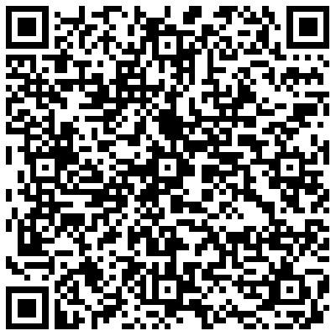
Crea un account google

Slide 7

Giochiamo!

Slide 8

Congratulazioni!

Slide 9






Promoting Inclusive Employment in the GLAM Sector through Open Innovation
Project No: 2022-1-AT01-KA220-ADU-00008513

