Slide 1
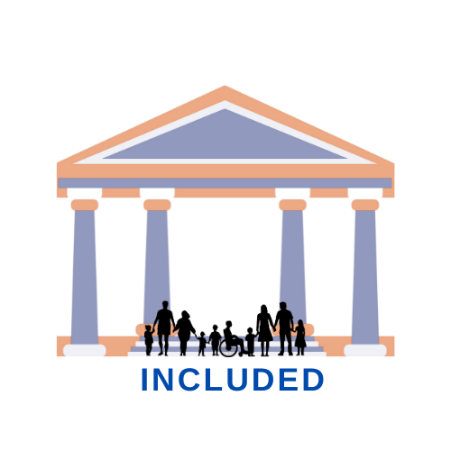

Blended learning course
Promoting Inclusive Employment in the GLAM Sector through Open Innovation
Module 1: Digital Transformation Post-COVID in the GLAM Sector
Session 4
Developed by:
SYNTHESIS Center for Research and Education
„Funded by the European Union. Views and opinions expressed are however those of the author(s) only and do not necessarily reflect those of the European Union or OeAD-GmbH. Neither the European Union nor the granting authority can be held responsible for them.“ Project No: 2022-1-AT01-KA220-ADU-00008513

Slide 2
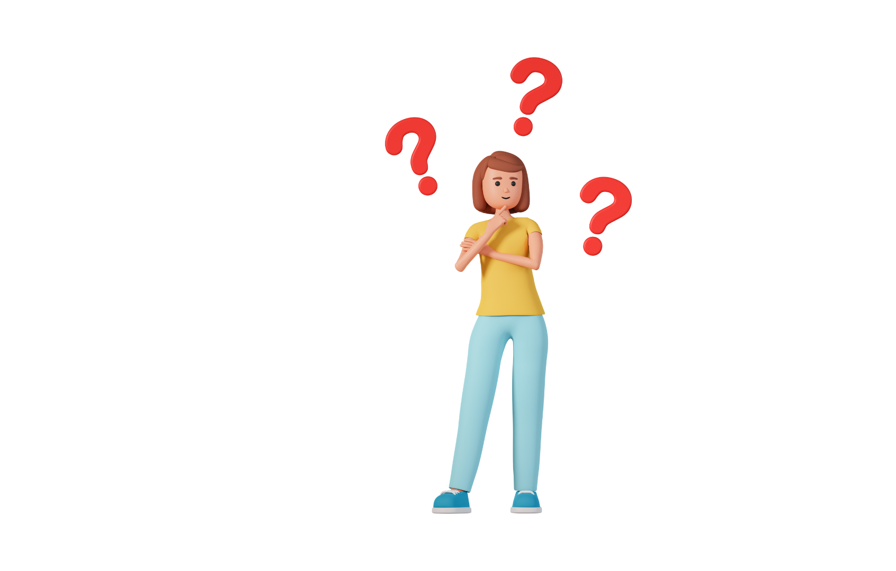

What is digital transformation?
What are some of the emerging job roles for GLAM professionals post-COVID?
Notes:
Welcome to the module on The digital GLAM-sector. The aims of this session are twofold:
First, to recruit interest in digital competencies required for the GLAM sector.
Second, to connect digital skills and the different job roles in the GLAM sector.
In terms of the intended learning outcomes, on completion of this online session, it is expected that the learner will discover foundational digital skills related to working in the GLAM sector.
In addition, on completion of these tasks, it is expected that the learner can define and recall key competences required for success in the GLAM sector.

Slide 3
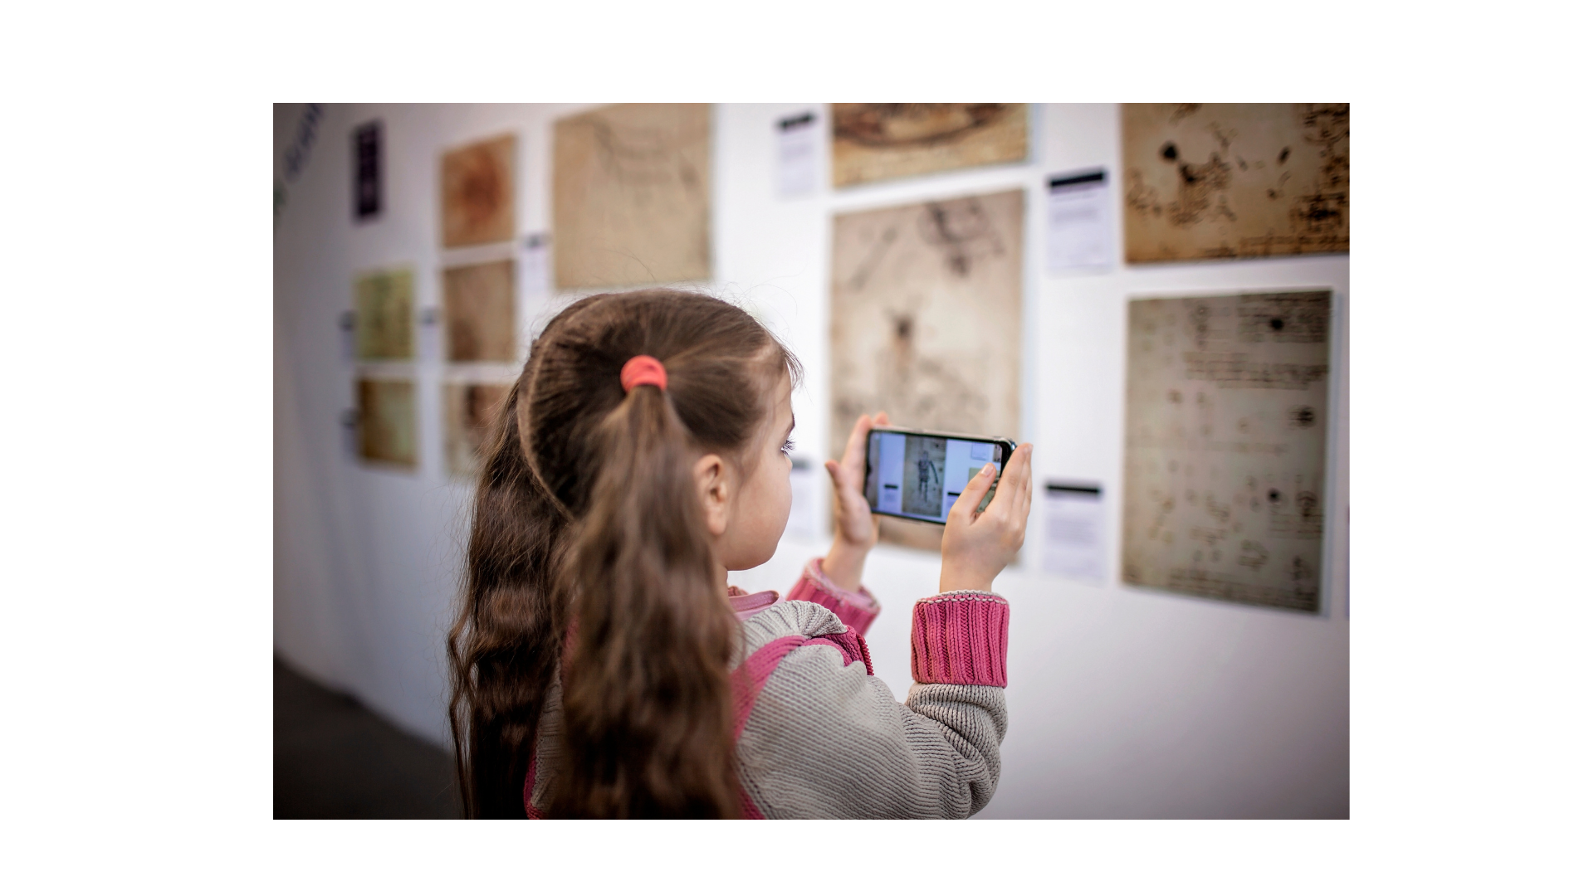

Part 2: Museums go digital

Slide 4

To digitise or not?

Slide 5
Digital museums
How can museums benefit from digital innovation?
Why are less than half of the world’s collections online?

Slide 6
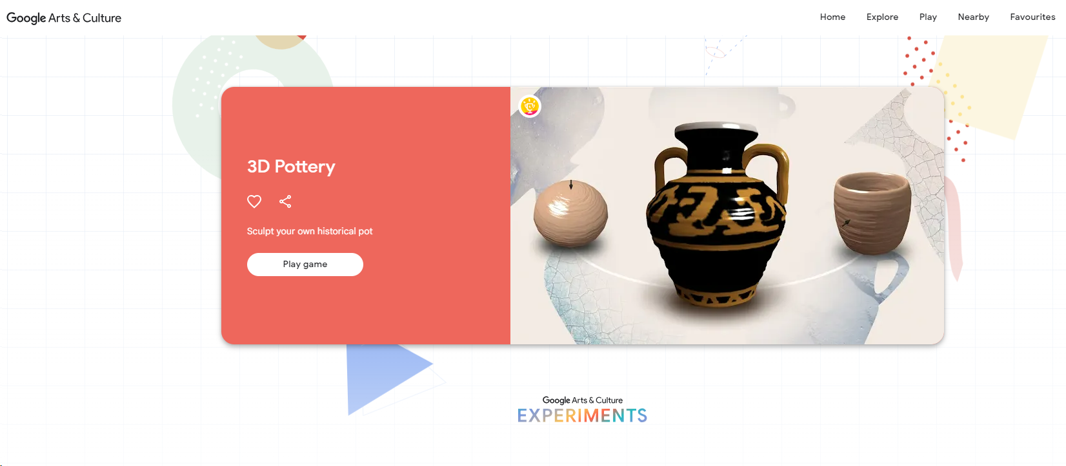
Let’s play
In groups of two, visit the link below and experiment with 3D pottery!
https://artsandculture.google.com/experiment/3d-pottery/nwHg1D0riJ1ltA

Slide 7
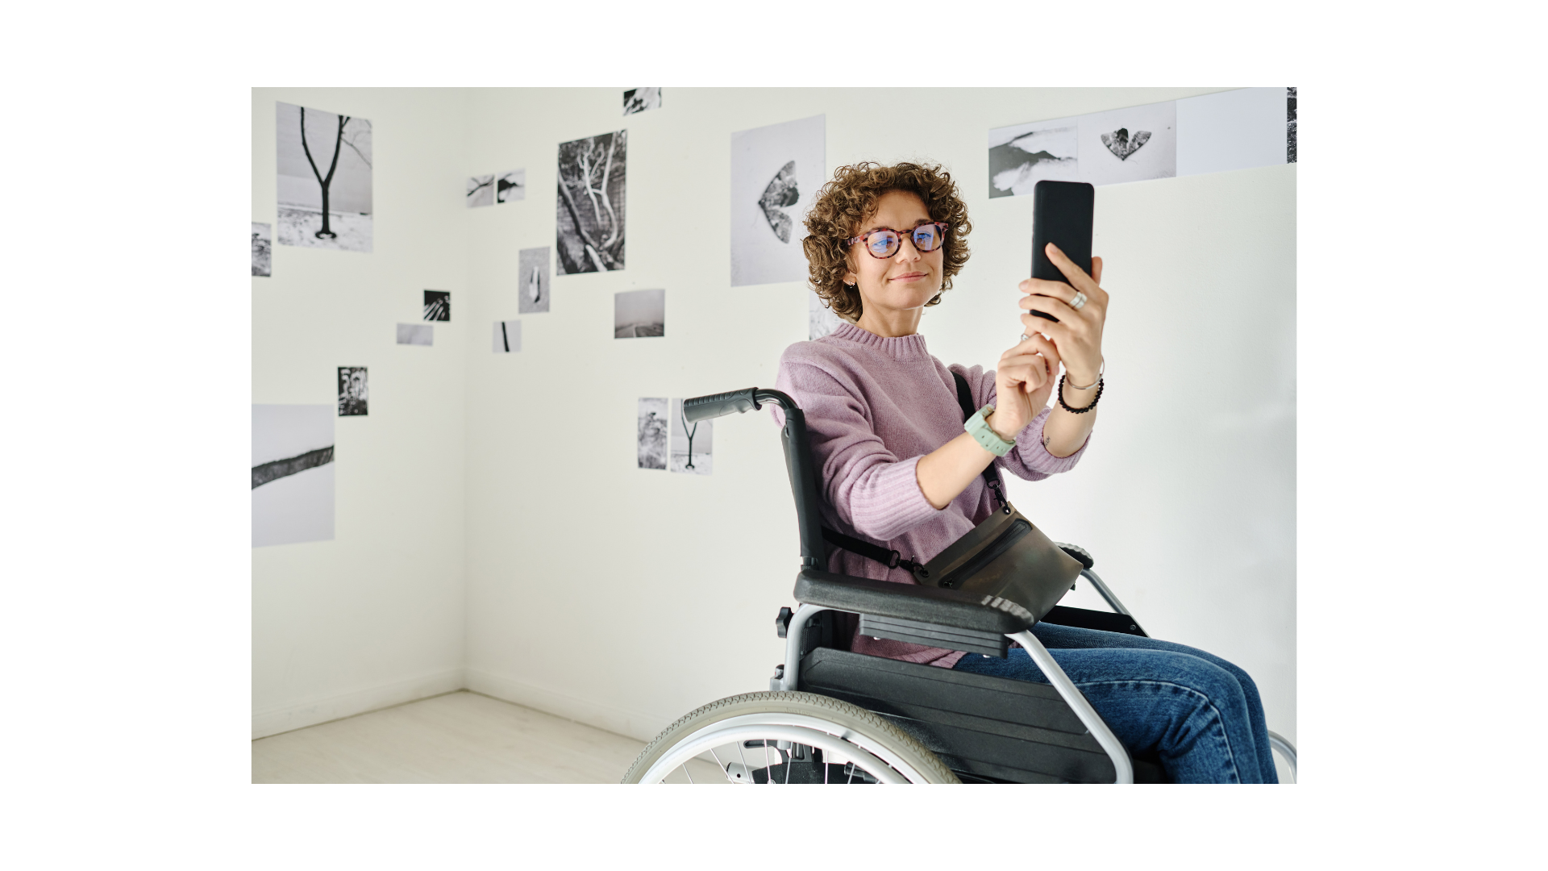
Part 3: Digital collections and the online experience

Slide 8

The Digital Transformation Agenda and GLAMs
Europeana, or European Digital Library, is a pan-European digital library that gives access to two million books, maps, audio recordings, photographs, archival documents, paintings and films from national libraries and cultural institutions in the 27 Member States of the European Union.
Notes:
Europeana, or European Digital Library, is a pan-European digital library that gives access to two million books, maps, audio recordings, photographs, archival documents, paintings and films from national libraries and cultural institutions in the 27 Member States of the European Union.

Slide 9
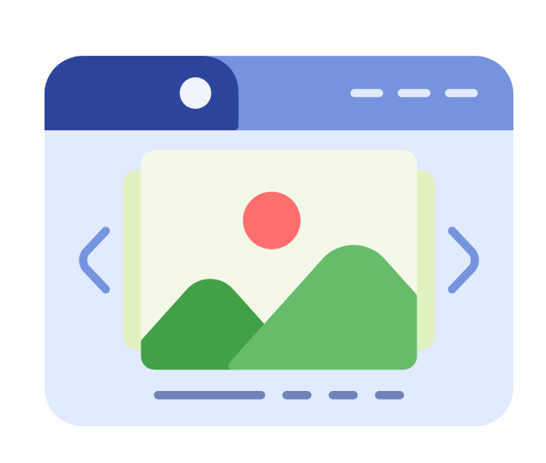
Digital Collections Curation
Virtually created digital "objects" are starting to find their way into museum collections. GLAM institutions need to enhance the specialized abilities of their curators in this growing field if they are to fulfill their missions of conserving cultural materials, carrying out research, and instructing future generations.
Notes:
The Digital Collections Curator is responsible for implementing the digital strategy relevant to collecting, storing, archiving, preserving and making accessible the digital collections (either born – digital or digitized). In larger museums this could be a role-profile in itself, while in smaller museums a curator should be up skilled in the area.

Slide 10
Discover Europe’s digital cultural heritage | Europeana
Go to Europeana collections.
See how the page is built under different categories.
Do you think the platform is accessible to diverse learners?
Are the categories appropriate for the user to retrieve the collections?
Notes:
In 2020, a report was commissioned by Europeana to help them understand how best to move forward to support and promote a ‘digital transformation agenda’ within their network of GLAM institutions.
The term produced informs the strategic priorities of Europeana and cultural institutions across Europe and beyond.
“Digital transformation is both the process and the result of using digital technology to transform how an organisation operates and delivers value. It helps an organisation to thrive, fulfil its mission and meet the needs of its stakeholders. It enables cultural heritage institutions to contribute to the transformation of a sector powered by digital and a Europe powered by culture.”

Slide 11
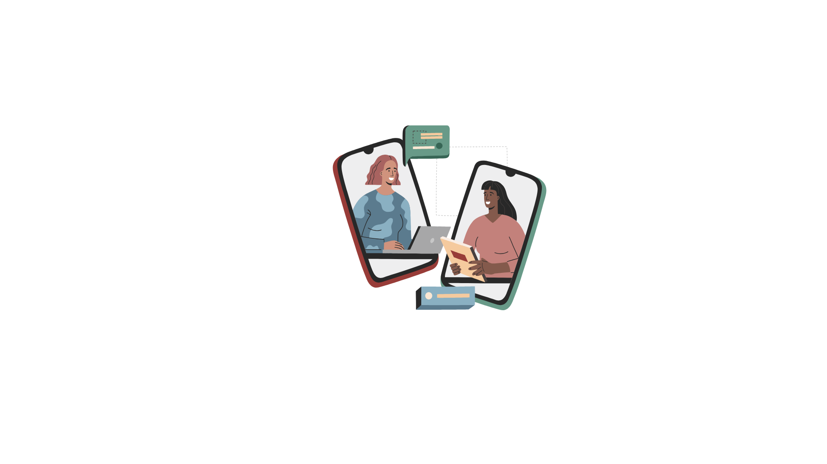
Part 4: Digital Social Media in GLAM

Slide 12
Social media manager/online community manager
One of the new roles in the GLAM sector is that of an online community manager. S/he creates and manages accessible and collaborative online communities for all stakeholders.
Take a look at the Heritage Digital’s Social Media Policy document and discuss/complete the different parts with your peers and the support of your trainer.

Slide 13
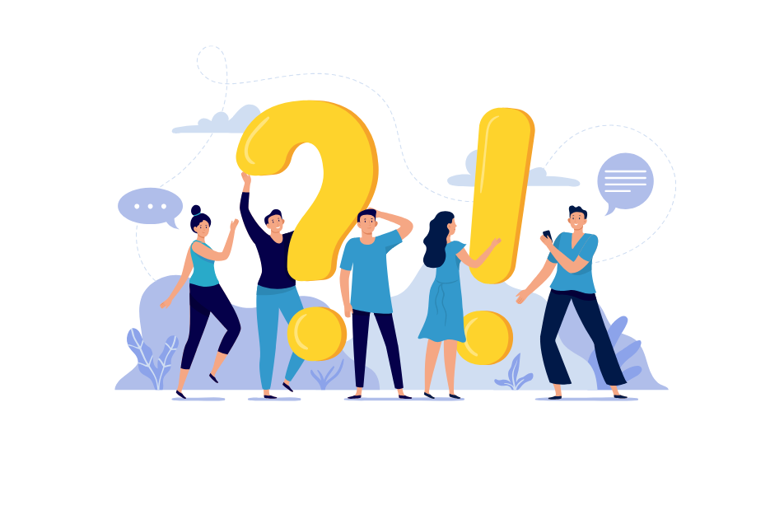
Self reflection
What are digital collections and what is the relevant job role/profile?
Do you think that going digital has potential to make GLAM institutions more accessible?
How are social media affecting accessibility, if at all?
Notes:
What is digital transformation?
What are some of the emerging job roles for GLAM professionals post-COVID?

Slide 14
References
Culture 24 (2020). The digital transformation agenda and GLAMs - Culture24 findings and outcomes, p. 14, 18.
https://pro.europeana.eu/files/Europeana_Professional/Publications/Digital%20transformation%20reports/The%20digital%20transformation%20agenda%20and%20GLAMs%20-%20Culture24,%20findings%20and%20outcomes.pdf
MuSA (2017). Emerging job profiles for the museum professionals. http://www.project-musa.eu/wp-content/uploads/2020/06/MuSA-Emerging-Job-Profiles-for-museum-professionals.pdf
https://docs.google.com/document/d/15sigmjFi0f6RQItrD9HzXXlS8k0nWdH5/edit

Slide 15

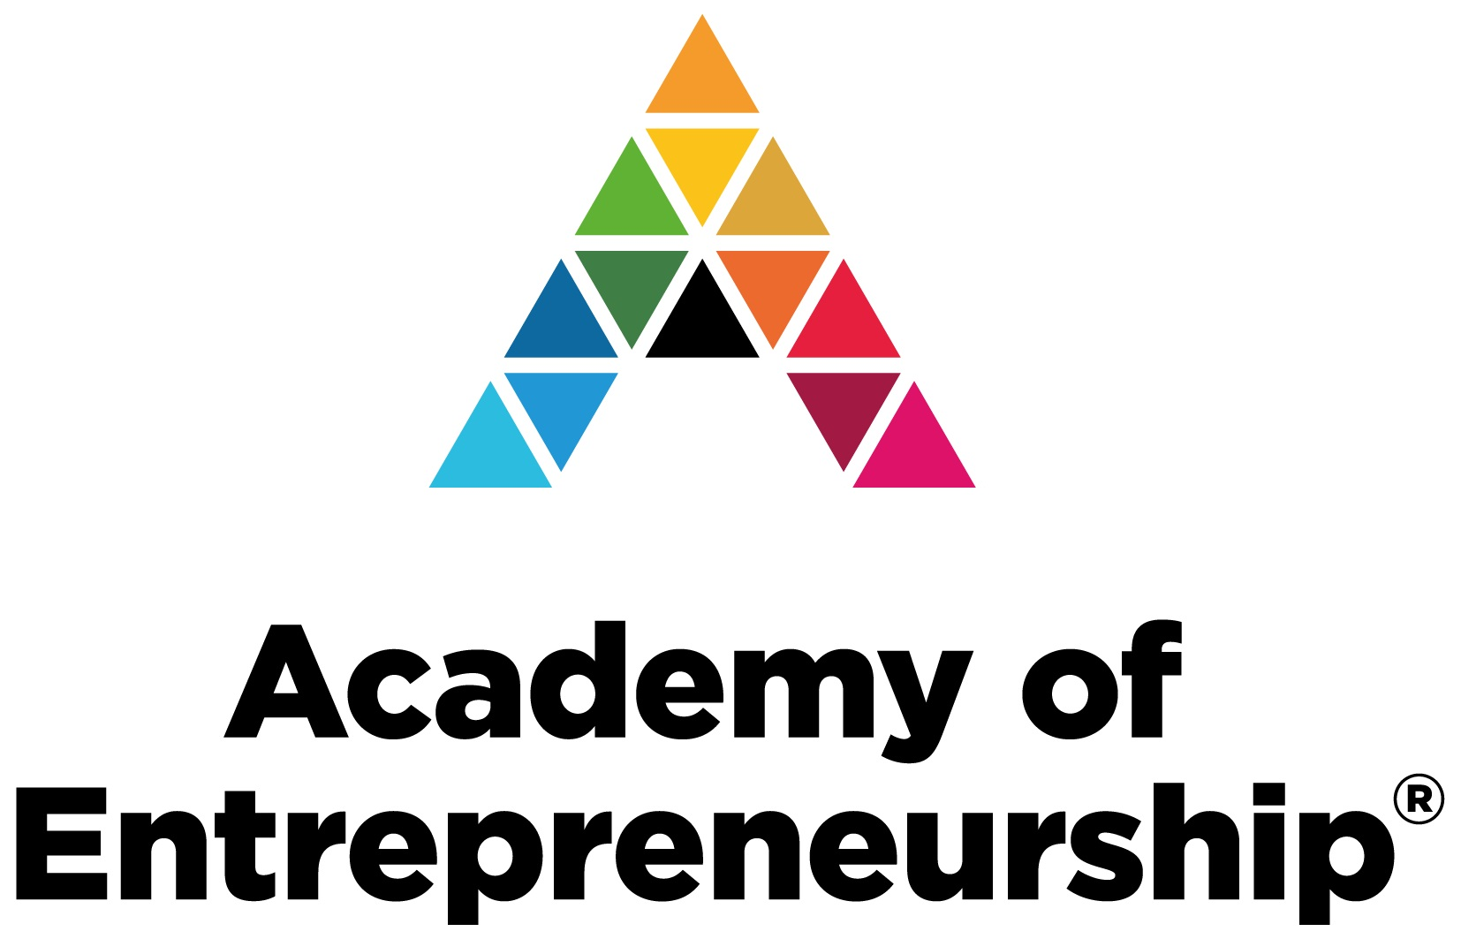

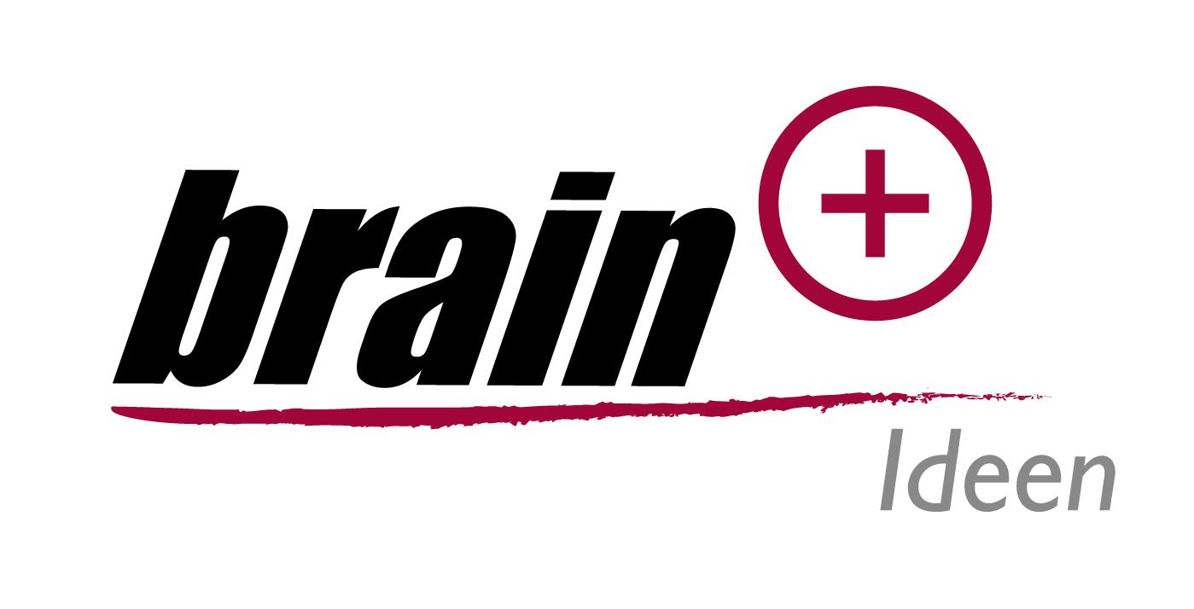

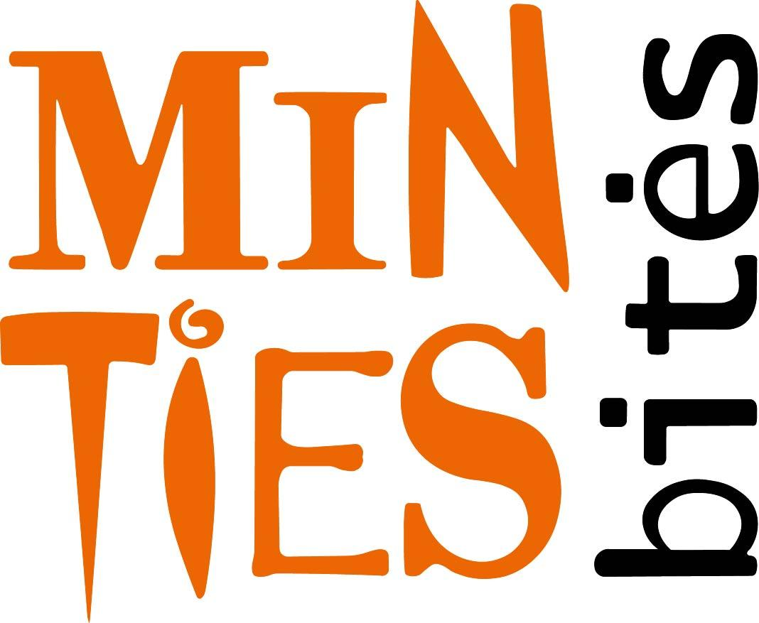
Promoting Inclusive Employment in the GLAM Sector through Open Innovation
Project No: 2022-1-AT01-KA220-ADU-00008513

