Slide 1


Blended learning course
Promoting Inclusive Employment in the GLAM Sector through Open Innovation
Module 1: NAVIGATING AROUND ONLINE
Session 3
Developed by:
SYNTHESIS Center for Research and Education
„Funded by the European Union. Views and opinions expressed are however those of the author(s) only and do not necessarily reflect those of the European Union or OeAD-GmbH. Neither the European Union nor the granting authority can be held responsible for them.“ Project No: 2022-1-AT01-KA220-ADU-00008513

Slide 2
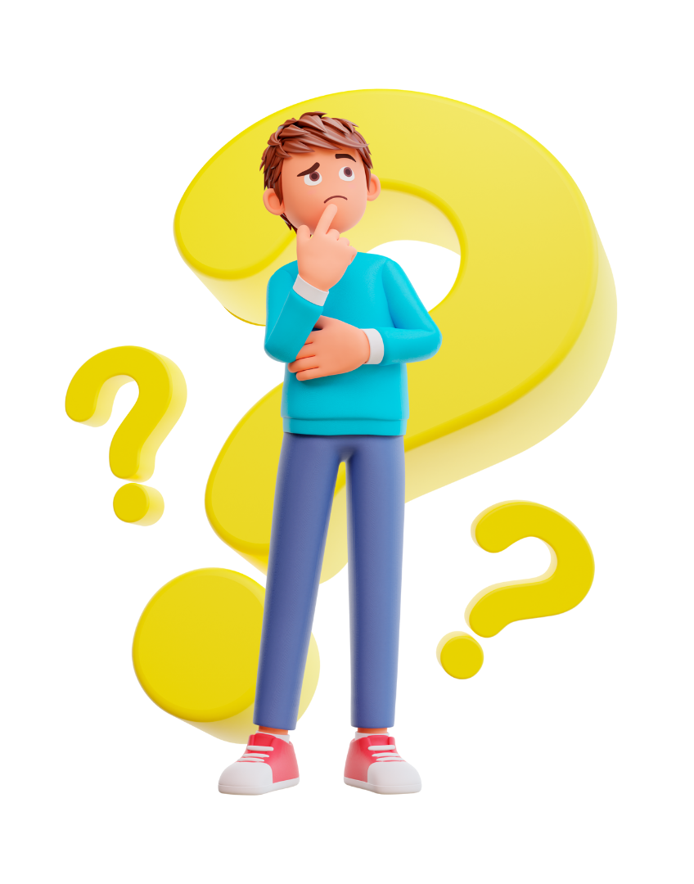

What is online navigation?
How often do you come across accessible websites?

Slide 3

Part 2: How the Internet works

Slide 4

How does the Internet work?

Slide 5
Examples of navigating the Internet
Why do you use the Internet?
Discuss with your group and trainer different examples of navigating the Internet.

Slide 6

Part 3: How to navigate the Internet

Slide 7
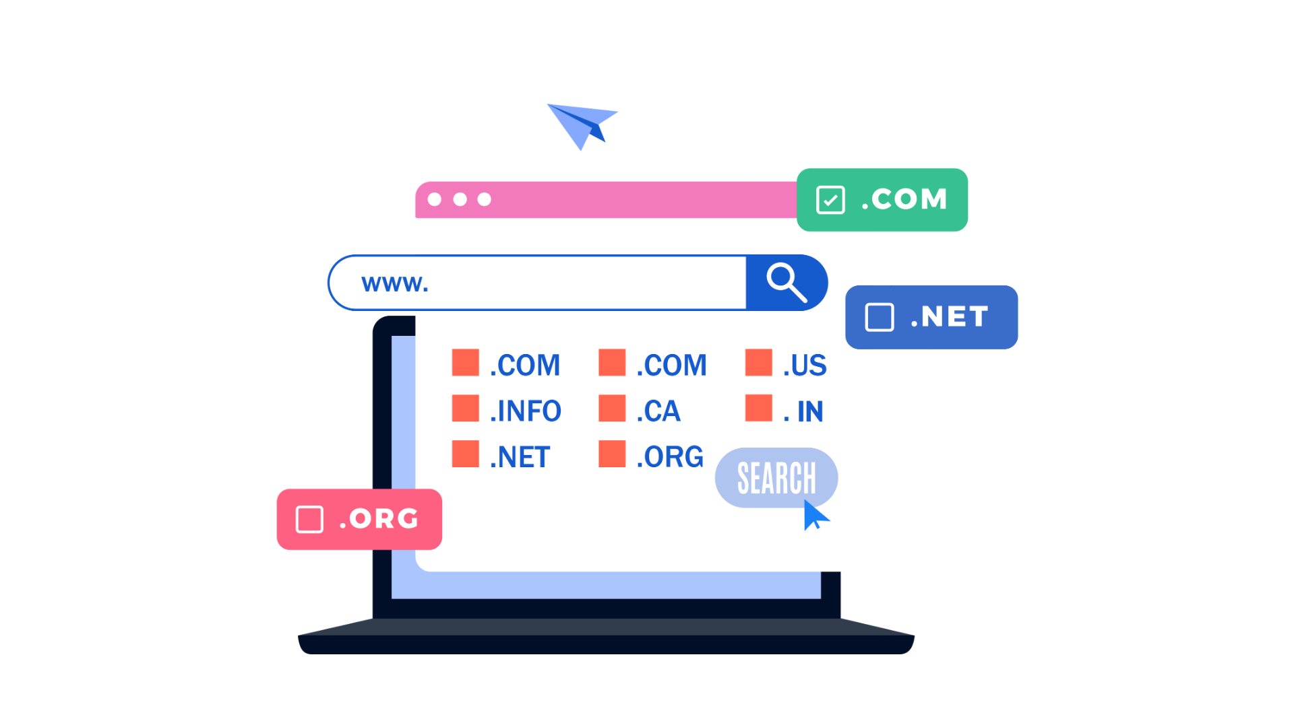
Types of Web Addresses
.com = Commercial/Business
.edu = Educational Institution
.org = Nonprofit Organization
.net = Internet Network
.mil = Military
.gov = Government Agency

Slide 8
Typing in a web address (URL)
Use your device and open the browser you frequently use.
Type in the following web address:
https://www.louvre.fr/en
See if everyone is on the same website. You can spend a few minutes navigating the website of the Louvre Museum. In 2022, 7.8 million art-lovers visited the Louvre, making it the most visited museum in the world.

Slide 9
Following links
In this slide, you find a link to redirect you to the
Google Arts and Culture.
Google Arts & Culture is an online platform with high-resolution images and videos of artworks and cultural objects from partner cultural organisations around the world.

Slide 10
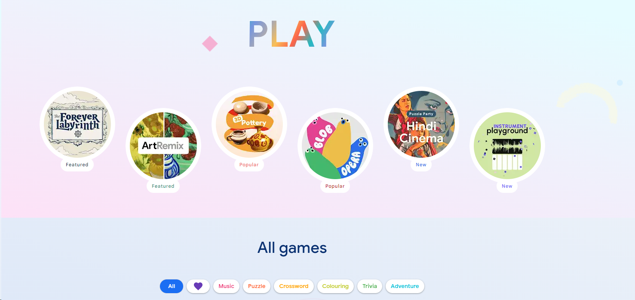
Following links
From the top menu bar on the right of the Google Arts and Culture website, choose Play. There are different options for games, choose ArtReMix and experiment with your peers.

Slide 11
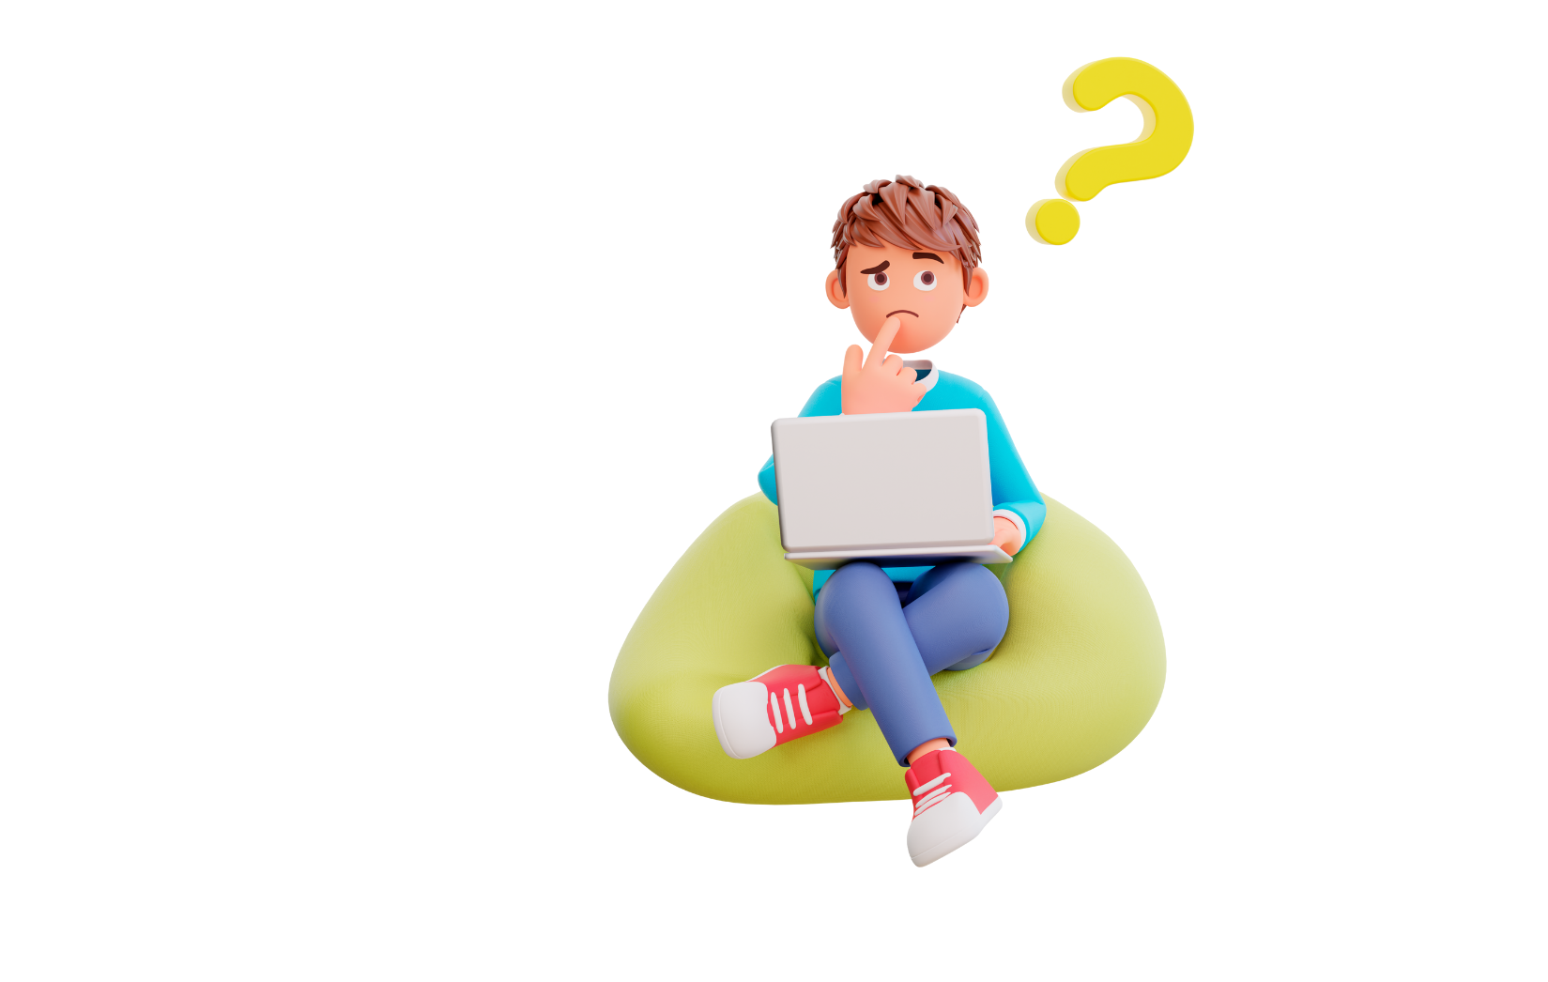
Finding a website using a search engine
Daniel is looking for the website of the Boston Children’s Library. How can he find it online?
A search engine can be useful.
Can you help? Use a search engine to find the URL and check with your trainer if it is correct. Make sure you use key terms for your search.
Notes:
The correct link is:
https://www.bpl.org/services-central-library/childrens-library-at-the-central-library/

Slide 12
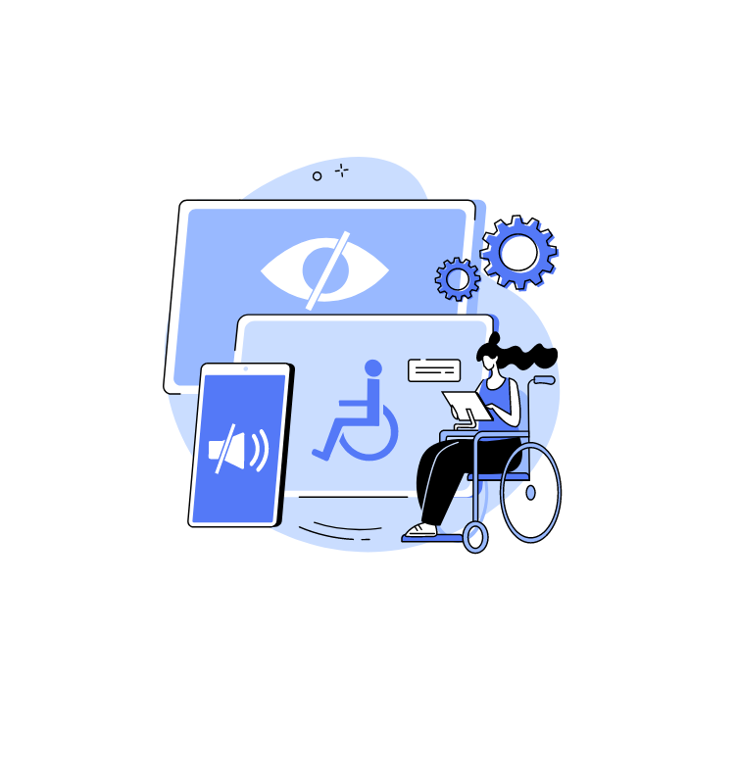
Part 4: Digital accessibility in the GLAM sector

Slide 13
Digital accessibility
Digital accessibility guarantees that online materials and museum websites are usable by people with disabilities. Making sure inclusive interactive displays accommodate a range of learning styles and abilities is also important.
Resources:
VocalEyes – Accessibility Resources for Museums

Slide 14
Accessible GLAM websites
Meaningful content, seen and heard
The easiest way to improve digital accessibility is to add "alt text," or alternative text, to a website. If a website's user cannot view an image, alt text provides a brief explanation of the image and is essential.

Slide 15
Accessible GLAM websites
Limiting language barriers
To provide legibility for visitors with disabilities, museum websites must, at the very least, be compatible with web standard speech-enabled software.

Slide 16
Accessible GLAM websites
Navigating digital accessibility
Optimizing the user experience on a digital platform is a science and an art in and of itself, as any IT expert will confirm.
Clearly identify and style hyperlinks inserted into text. The classic underlining is just one of several ways to improve link styles for greater accessibility.

Slide 17
Accessible GLAM websites
Navigating digital accessibility
Even in cases where users are unable or do not possess a mouse, the main controls on a website must to be equally accessible. It's challenging to strike a balance between design and digital accessibility, particularly when the museum website needs to be user-friendly for both persons with disabilities and those without. By using a prominent "point of regard" sign, several museums offer improved primary navigation.

Slide 18
Accessible GLAM websites
Navigating digital accessibility
Similar to the zoom feature, enabling keyboard navigation on all or some portions of a website will benefit all users.

Slide 19
Examples of accessible virtual tours and visits
1. The British Museum
The British Museum has an excellent range of virtual tours and digital resources for you to delve into from the comfort of your very own sofa. Pick of the bunch is the Museum of the World, a collaborative project with Google Cultural Institute.
The British Museum also has a dedicated accessibility page on their website; if you need any extra help with their online resources, email access@britishmuseum.org

Slide 20
Examples of accessible virtual tours and visits
2. Rijksmuseum
Travel to Amsterdam (almost there!) and visit the Rijksmuseum. Google Arts and Culture is an app and website that gives you access to the museum and its amazing exhibitions. These platforms provide you access to the museum's vast collection of fascinating objects, and you may enlarge the screen to see them up close.
Other fascinating films with captions that explore a variety of subjects, like Rembrandt's artwork, can also be found online. Indeed, in 2019 the Rijksmuseum became the first museum to release a video in Dutch Sign Language, and there are already a ton of other sign language videos available on the internet.

Slide 21

Self-reflection
Do you consider that there is still a need for improvement to make online navigation more accessible and inclusive to all?
What would be your suggestion to make changes to include neurodivergent people?

Slide 22
References
https://codemantra.com/museums-ensuring-digital-accessibility-for-all/
https://news.motability.co.uk/places/8-accessible-virtual-tours-and-visits/
https://ercim-news.ercim.eu/en130/special/digitally-enhanced-museum-accessibility-in-post-covid-era
https://www.museumnext.com/article/how-museums-can-make-their-websites-more-accessible/
https://vocaleyes.co.uk/services/museums-galleries-and-heritage/museum-resources/

Slide 23



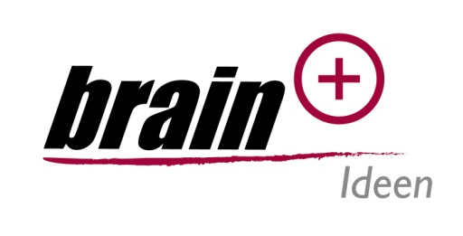


Promoting Inclusive Employment in the GLAM Sector through Open Innovation
Project No: 2022-1-AT01-KA220-ADU-00008513

