Slide 1
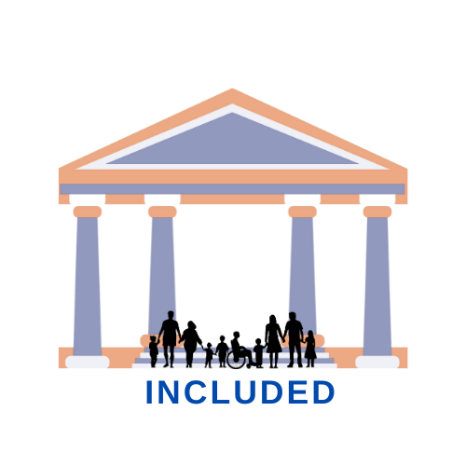

Blended learning course
Promoting Inclusive Employment in the GLAM Sector through Open Innovation
Module 1: The Digital GLAM-sector
Session 2: Being Digital in the GLAM Sector
Developed by: SYNTHESIS – Center of Research and Education (Cyprus)
„Funded by the European Union. Views and opinions expressed are however those of the author(s) only and do not necessarily reflect those of the European Union or OeAD-GmbH. Neither the European Union nor the granting authority can be held responsible for them.“ Project No: 2022-1-AT01-KA220-ADU-00008513

Slide 2
Aims of the session:
Learning outcomes:
Explore the transformative impact of digital technologies on cultural institutions.
Highlight the importance of being digitally proficient for success in GLAM roles.
Provide Examples of Good Practices for modelling and reflection.
Understand how digitalization has transformed cultural institutions.
Acquire knowledge on tools and strategies to apply digital transformation on cultural institutions.
Gain a holistic understanding of contemporary skills need to thrive to GLAM roles.

Slide 3
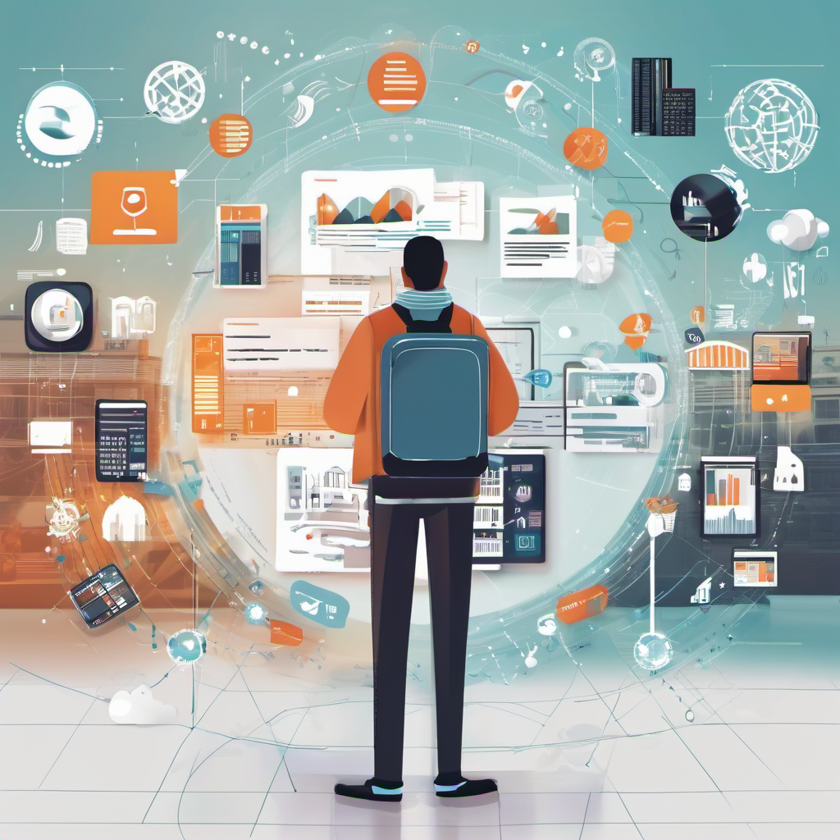
Part 1: Understanding the Importance of Digital Transformation
In recent years, the rapid advancement of digital technologies has revolutionized the way we interact, communicate, and engage with information and culture.

Slide 4
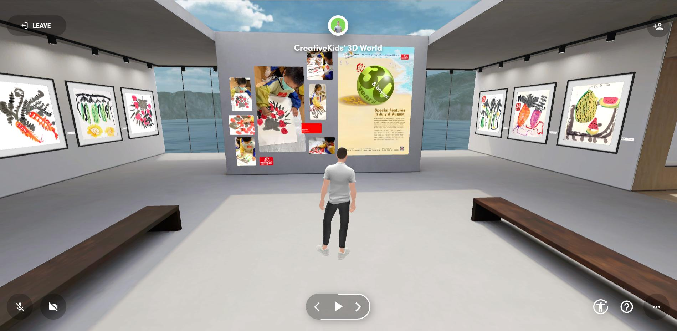
How this transformation was made?
From virtual exhibitions to digital archives, these technologies have not only transformed the way cultural institutions operate but have also opened new avenues for accessibility, innovation, and collaboration.
Notes:
Photo retrieved from: https://creativekids.com.hk/virtual-summer-art-exhibition-2022/

Slide 5

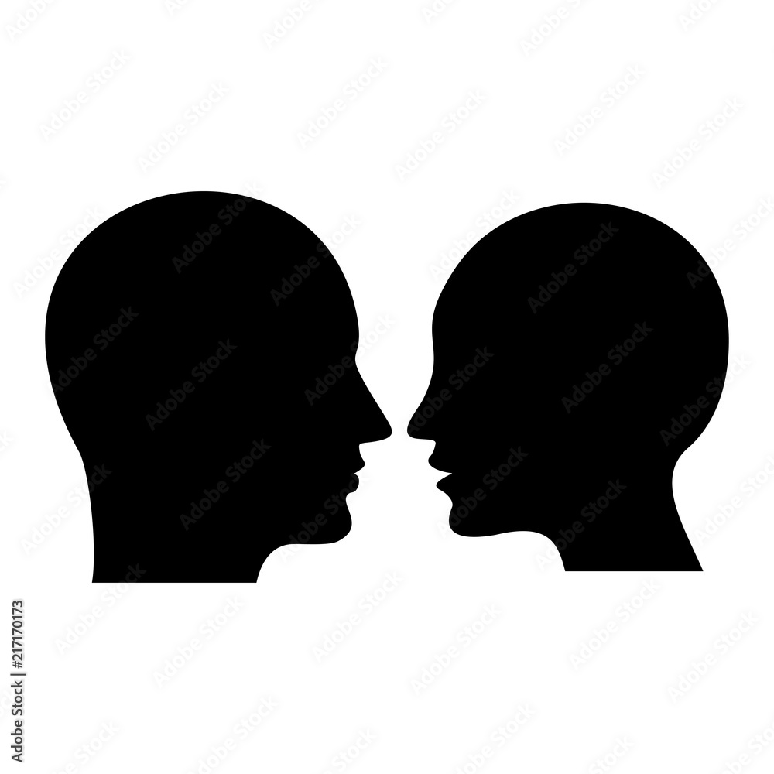

Key Drivers of Digital Transformation:
Changing Audience Expectations: Today's audiences expect seamless digital experiences that allow them to engage with cultural content anytime, anywhere.
Technological Innovation: The rapid pace of technological innovation presents both challenges and opportunities for cultural institutions.
Global Trends and Challenges: Global trends such as globalization, urbanization, and climate change.

Slide 6



Benefits of Digital Transformation
IMPROVING OPERATIONAL EFFICIENCY AND COST-EFFECTIVENESS
ENHANCING AUDIENCE ENGAGEMENT
FOSTERING INNOVATION

Slide 7
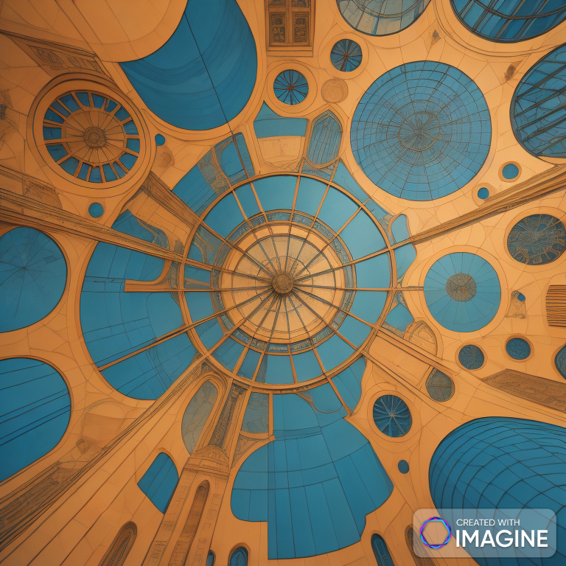
Part 2: How covid19 pandemic and lockdown affected the cultural sectors?

Slide 8
How Covid19 pandemic and lockdown affected the cultural sectors?
Ushered the cultural institutions and GLAM sector in general to adopt new technologies and digitalisation.
Offer to the public the chance to still visit/interact with culture and arts.
To help safeguard their surviving,

Slide 9
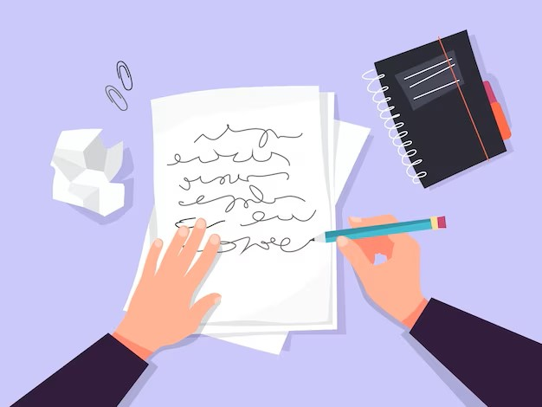
Activity 1
Take pen & paper and write down a list of benefits of incorporating digital tools and options to the GLAM sector.
Notes:
Photo retrieved from Freepick

Slide 10

Part 3:The impact of covid19 pandemic on living heritage.
“ Our objective for this part of the session is to explore the impact of the COVID-19 pandemic on living heritage and discover how communities have shown resilience, solidarity, and inspiration during these challenging times through the exchange of experiences.”
Notes:
Photo Retrieved from Freepick: <a href="https://www.freepik.com/free-vector/museum-visitors-walking-art-gallery-tourists-enjoying-exposition-admiring-artworks-exhibition-vector-illustration-excursion-people-culture-concept_10613248.htm#query=museums&position=0&from_view=search&track=sph&uuid=8ed8ac61-ebd5-41f2-84ab-1b2569ce1f5d">Image by pch.vector</a> on Freepik

Slide 11

UNESCO’s Initiative
UNESCO's initiative to gather experiences related to intangible cultural heritage during the pandemic.

Slide 12

Group Discussion
How has the COVID-19 pandemic affected intangible cultural heritage in your community or region?
Have you witnessed any examples of resilience, solidarity, or inspiration related to living heritage during the pandemic?
What lessons can we learn from these experiences, and how can they be applied to future challenges?
Notes:
Photo Retrieved from: <a href="https://www.freepik.com/free-vector/ballroom-palace-reception-hall-illustration-luxury-museum-chamber-room_3090607.htm#query=museums&position=23&from_view=search&track=sph&uuid=8ed8ac61-ebd5-41f2-84ab-1b2569ce1f5d">Image by vectorpocket</a> on Freepik

Slide 13
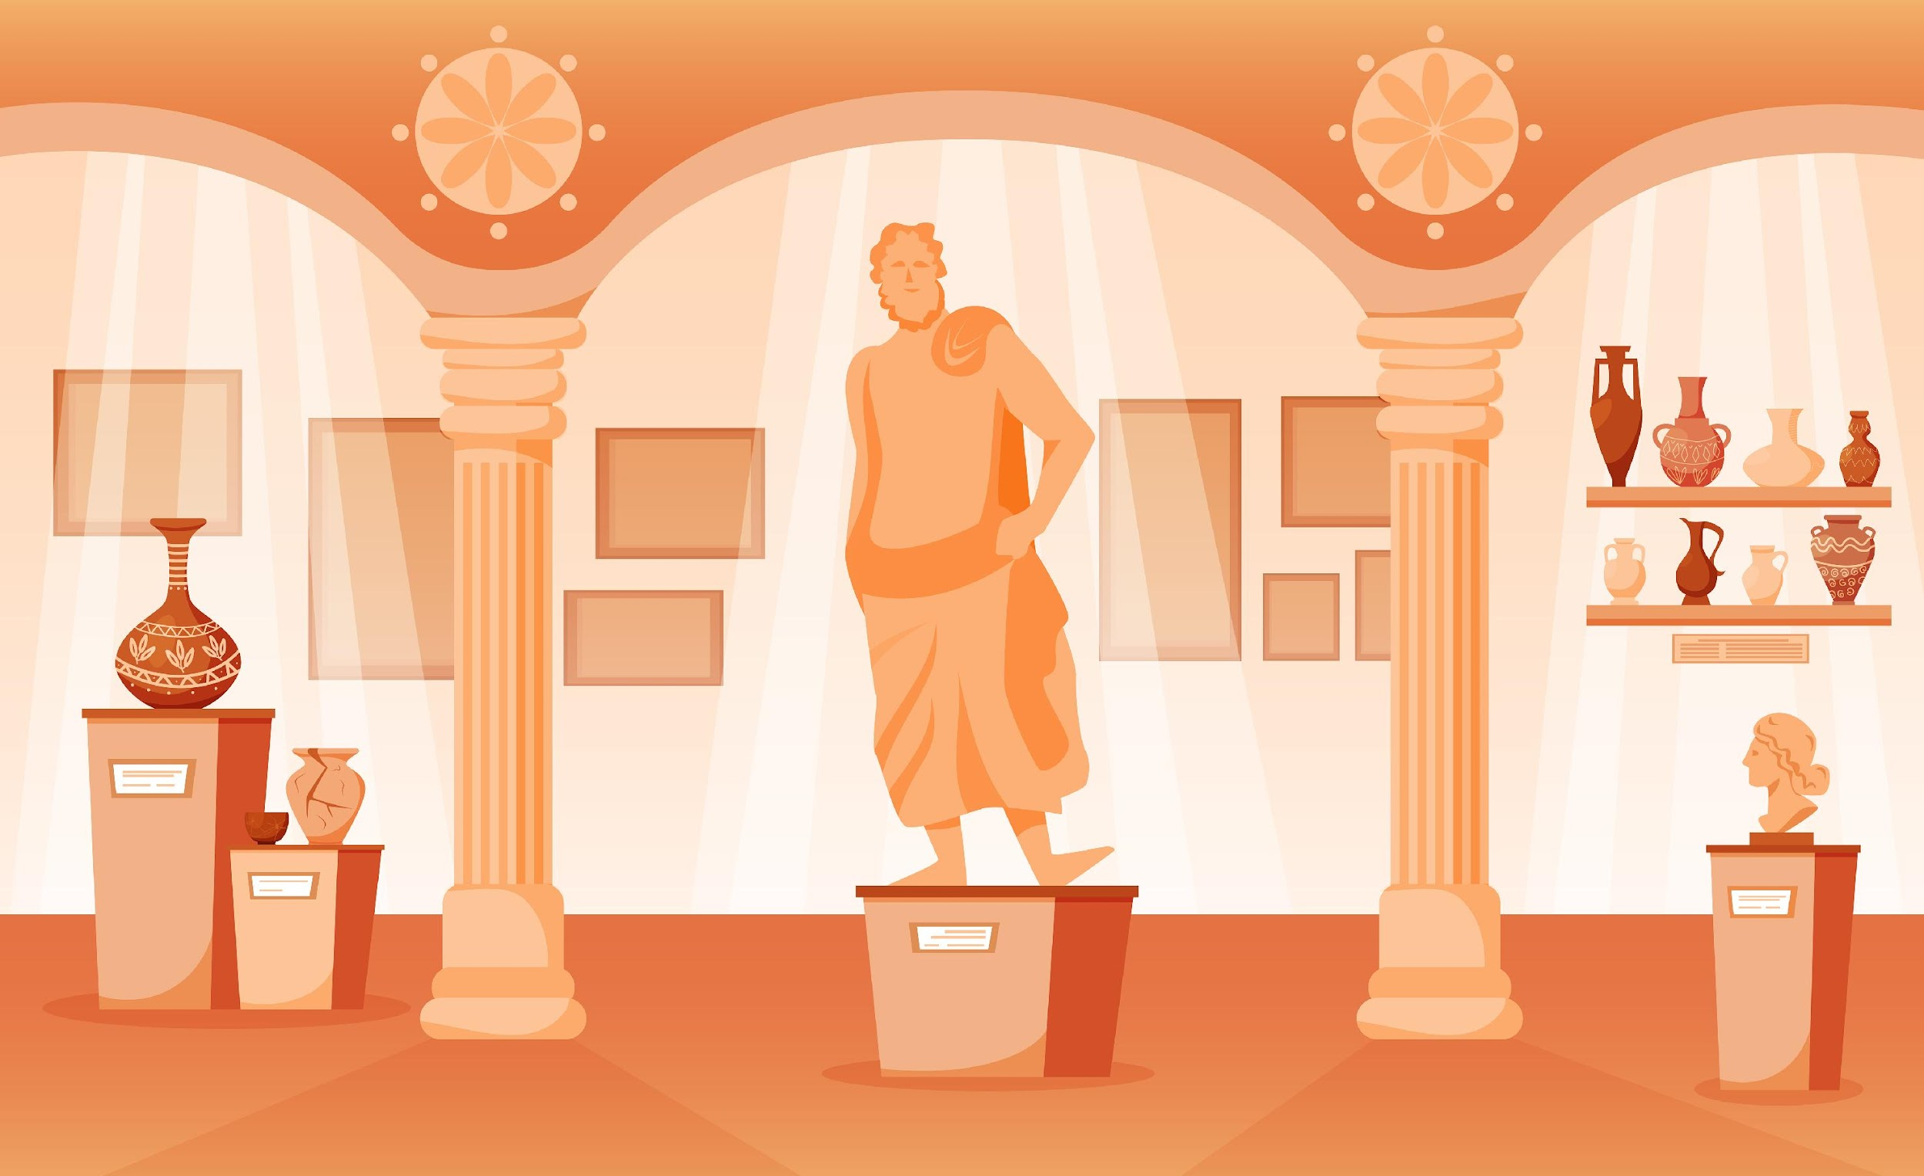
Part 4: Museums and Virtual Tours
Many museums around the world have offered virtual tours, especially during periods of closures or restrictions due to events like the COVID-19 pandemic.
Notes:
Image retrieved from: <a href="https://www.freepik.com/free-vector/museum-interior-flat-background_26766300.htm#query=museums&position=22&from_view=search&track=sph&uuid=8ed8ac61-ebd5-41f2-84ab-1b2569ce1f5d">Image by macrovector</a> on Freepik

Slide 14
Benefits of Virtual Tours
Accessibility
Education
Promotion and Outreach
Cultural Preservation
Innovation and Adaptation

Slide 15
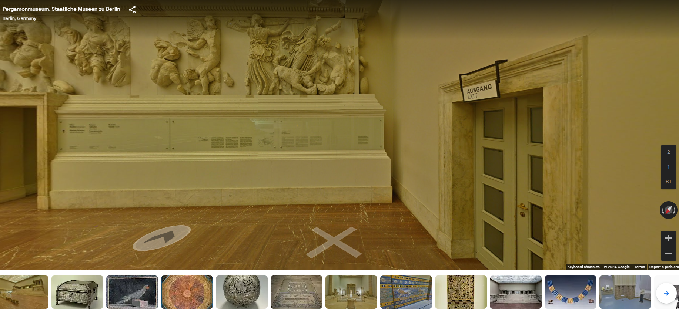
Activity 2
Browse through and write down notes and impressions (10 minutes)
  Pergamon Museum, Berlin: https://rb.gy/vxamm0
  Van Gogh Museum, Amsterdam: https://rb.gy/hwn1pg
  Uffizi Gallery, Florence: https://rb.gy/cgwn2j

Slide 16
Reflection
What did you like the most from the virtual tours?
What could be improved based on your observations?
Will you utilise these features again in the future?
Would you recommend it to other people? And if yes who and why?

Slide 17
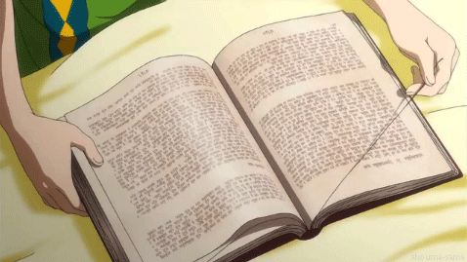
Final Thoughts
Any Questions?
Suggestions?
Final Remarks?

Slide 18

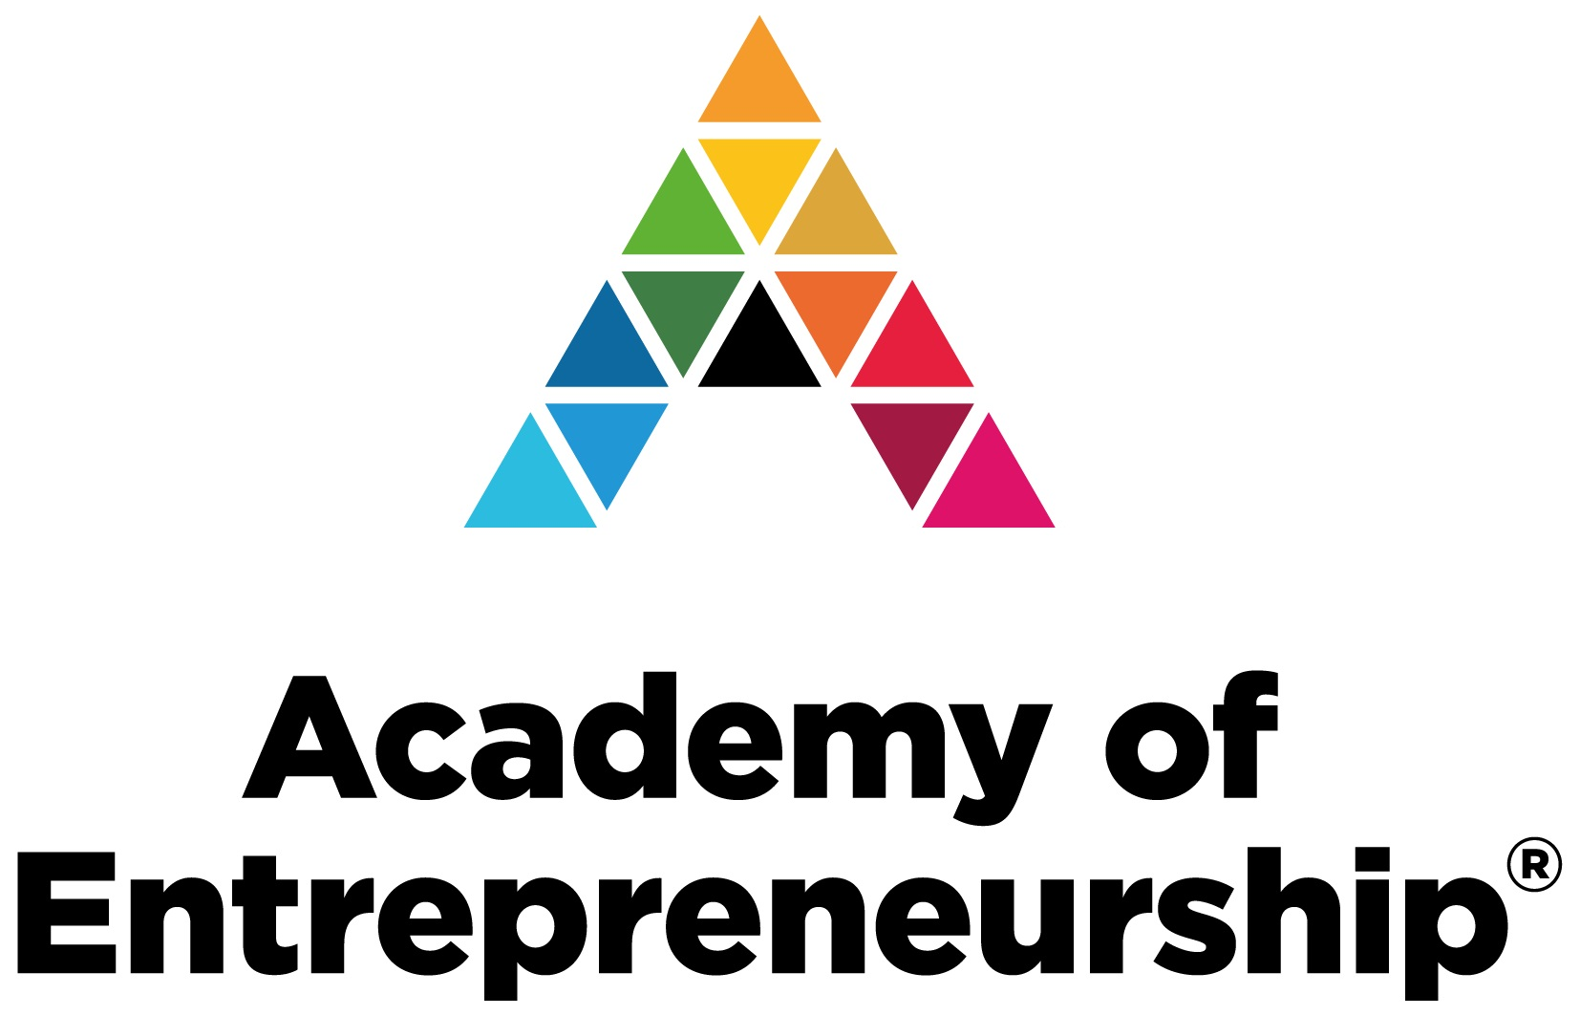

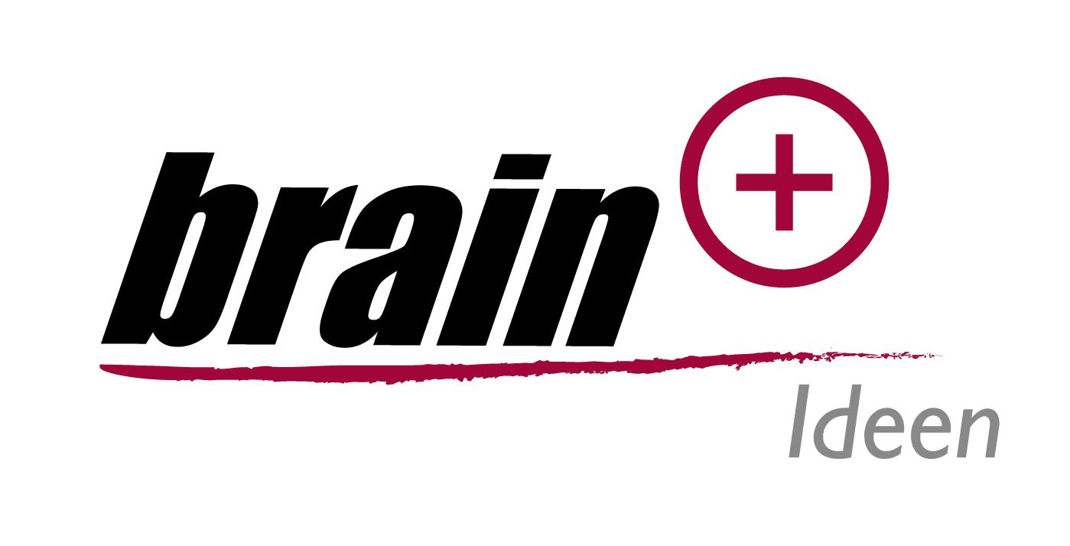

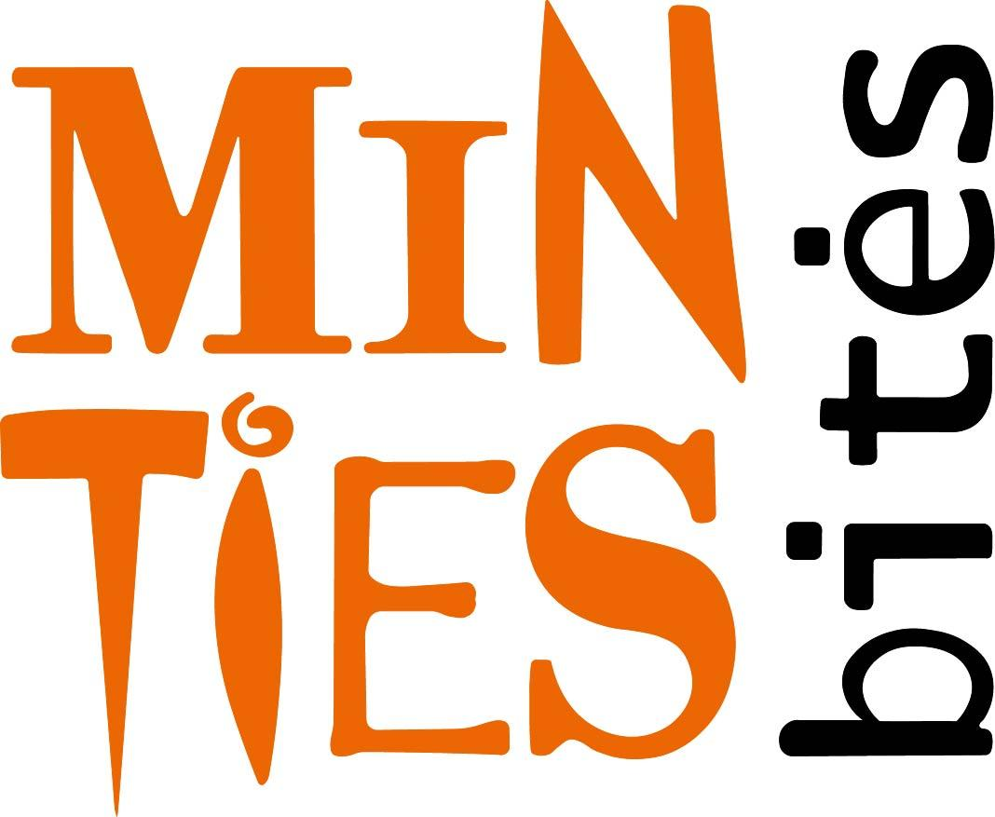
Promoting Inclusive Employment in the GLAM Sector through Open Innovation
Project No: 2022-1-AT01-KA220-ADU-00008513

