Slide 1


Blended learning course
Promoting Inclusive Employment in the GLAM Sector through Open Innovation
Module 1: The digital GLAM-sector
Session 1
Developed by:
SYNTHESIS Center for Research and Education
„Funded by the European Union. Views and opinions expressed are however those of the author(s) only and do not necessarily reflect those of the European Union or OeAD-GmbH. Neither the European Union nor the granting authority can be held responsible for them.“ Project No: 2022-1-AT01-KA220-ADU-00008513

Slide 2
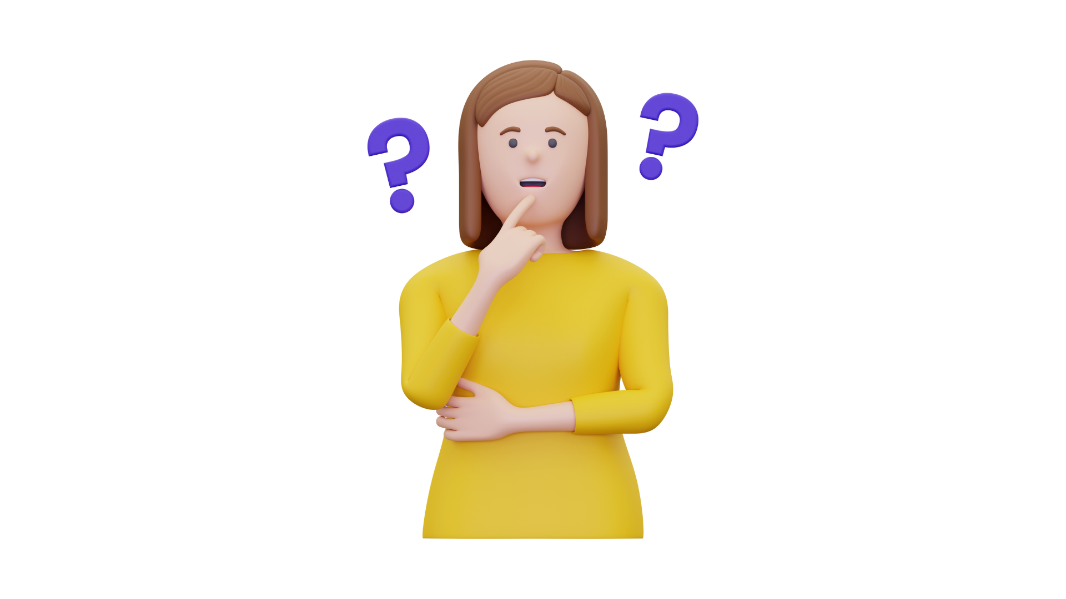
Why are digital skills important for GLAM?
What are some key digital competencies required when working in the GLAM sector?
Notes:
Welcome to the module on The digital GLAM-sector. The aims of this session are twofold:
First, to recruit interest in digital competencies required for the GLAM sector.
Second, to connect digital skills and the different job roles in the GLAM sector.
In terms of the intended learning outcomes, on completion of this online session, it is expected that the learner will discover foundational digital skills related to working in the GLAM sector.
In addition, on completion of these tasks, it is expected that the learner can define and recall key competences required for success in the GLAM sector.

Slide 3
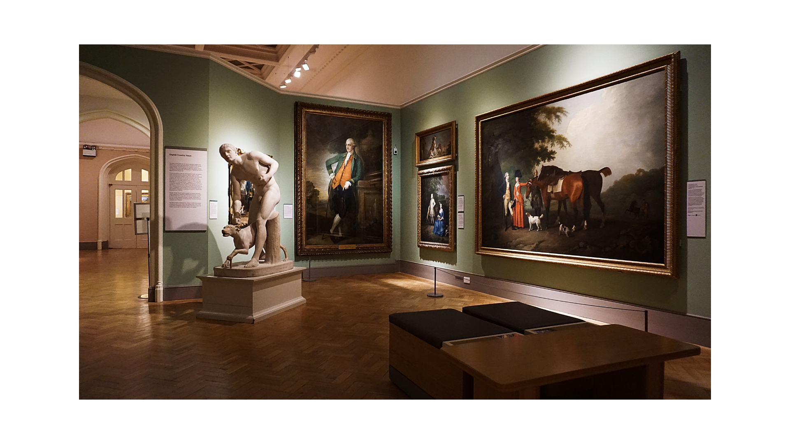

Part 2: Digital work in GLAM

Slide 4

The work of digital reconstruction

Slide 5
Athena in her true colors
What is polychromy?
What are the different steps for the digital reconstruction work for the sculpture of Athena and her true colors?

Slide 6
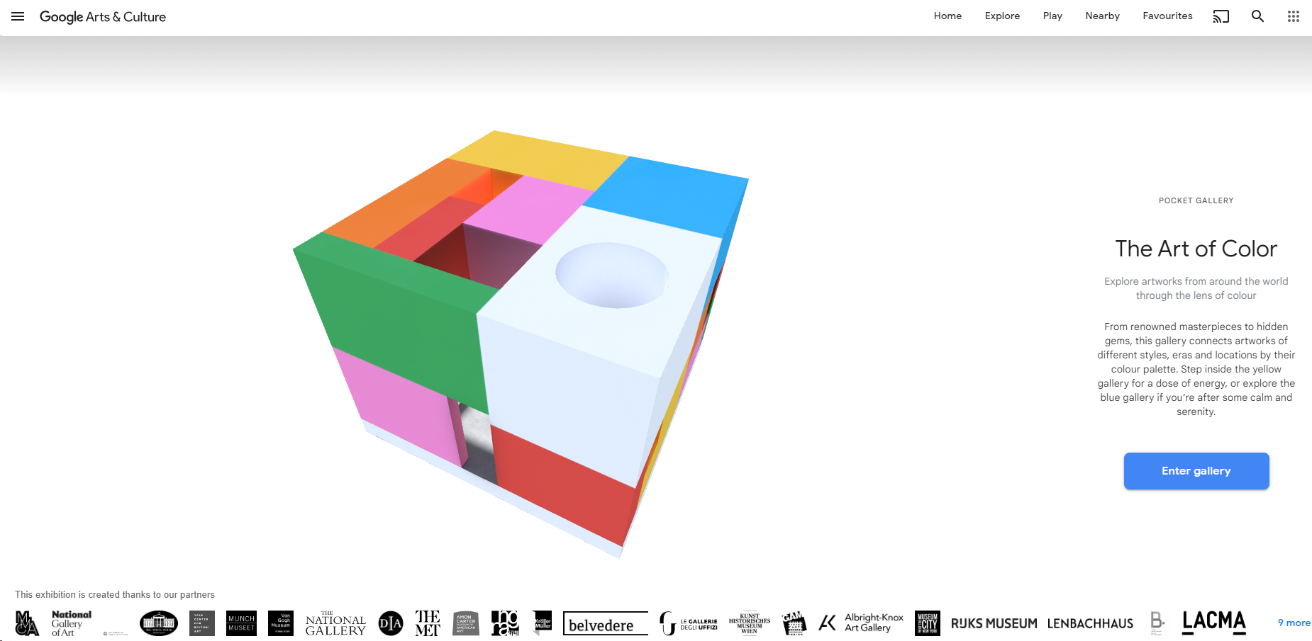
Let’s play
In groups of two, visit the link below and experiment with the art of color! https://artsandculture.google.com/pocketgallery/IQUxrMnvNro2DQ

Slide 7
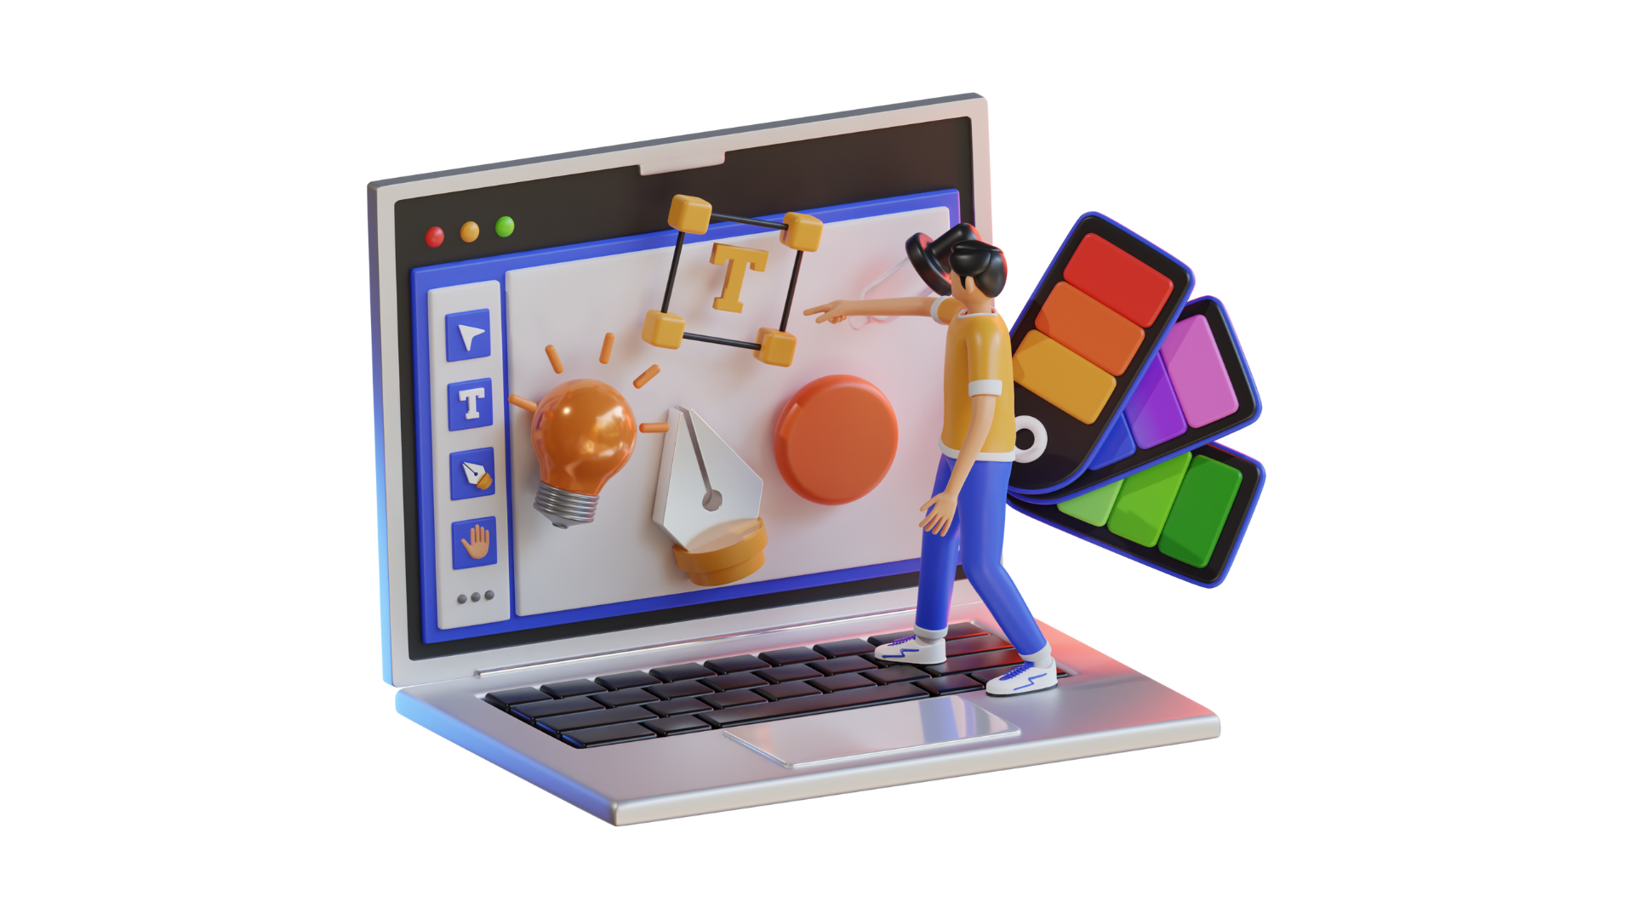
Part 3: Areas of digital competencies in the GLAM sector

Slide 8
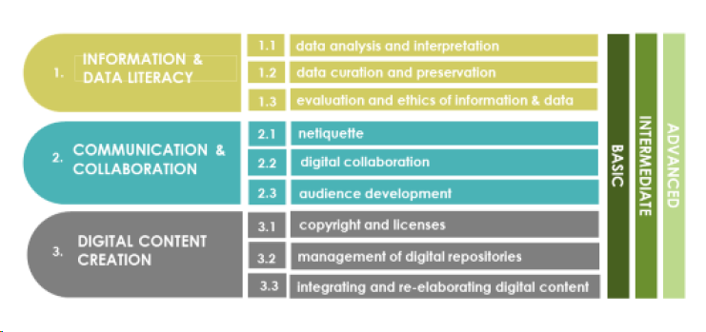
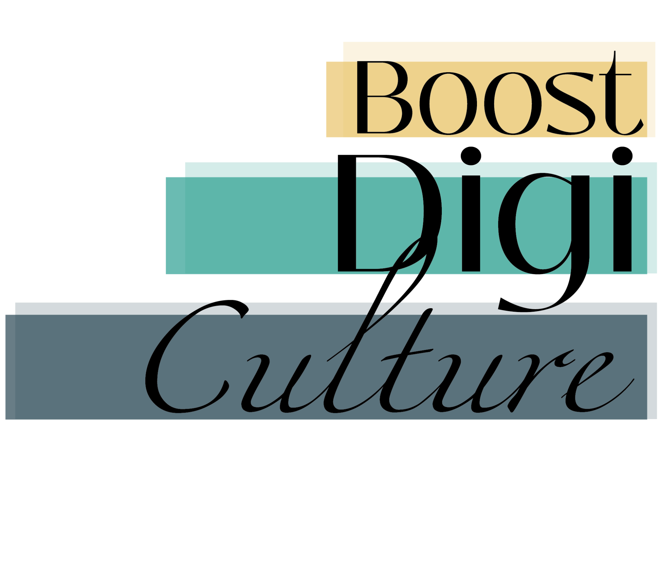
Areas of digital competencies for GLAM
Notes:
A recent European project, namely BoostDigiCulture, explores the sustainability pathways for digital upskilling of cultural professionals, especially those working in the GLAM sector. In this respect, the Erasmus funded project, has conducted research with focus groups and produced a report which serves as a guide for the areas of digital competences and skills, necessary for cultural professionals in a post-Covid era.
Three areas are identified from the research, deriving from The European Commission’s DigiComp 2.0 (The Digital Competence Framework 2.0), which identifies a set of key digital competences for European citizens.
Area one is Information and data literacy.
Area two is Communication and collaboration.
Area three is Digital Content Creation.
Each area has three relevant digital competence elements. Let’s take a closer look at each area.

Slide 9
Developing Digital Skills in GLAM
to understand and avoid risks associated with sensitive data
to be familiar with basic behavioural norms in digital environments
to be familiar with relevant policies, regulations and guidelines on data preservation and reuse, especially in the public sector
to be able to check and understand the right to use and/or re-use digital content created by a third party
to be aware of accessibility requirements when communicating in digital environments so that communication is inclusive and accessible for all users
to understand fundamentals of digital preservation

Slide 10
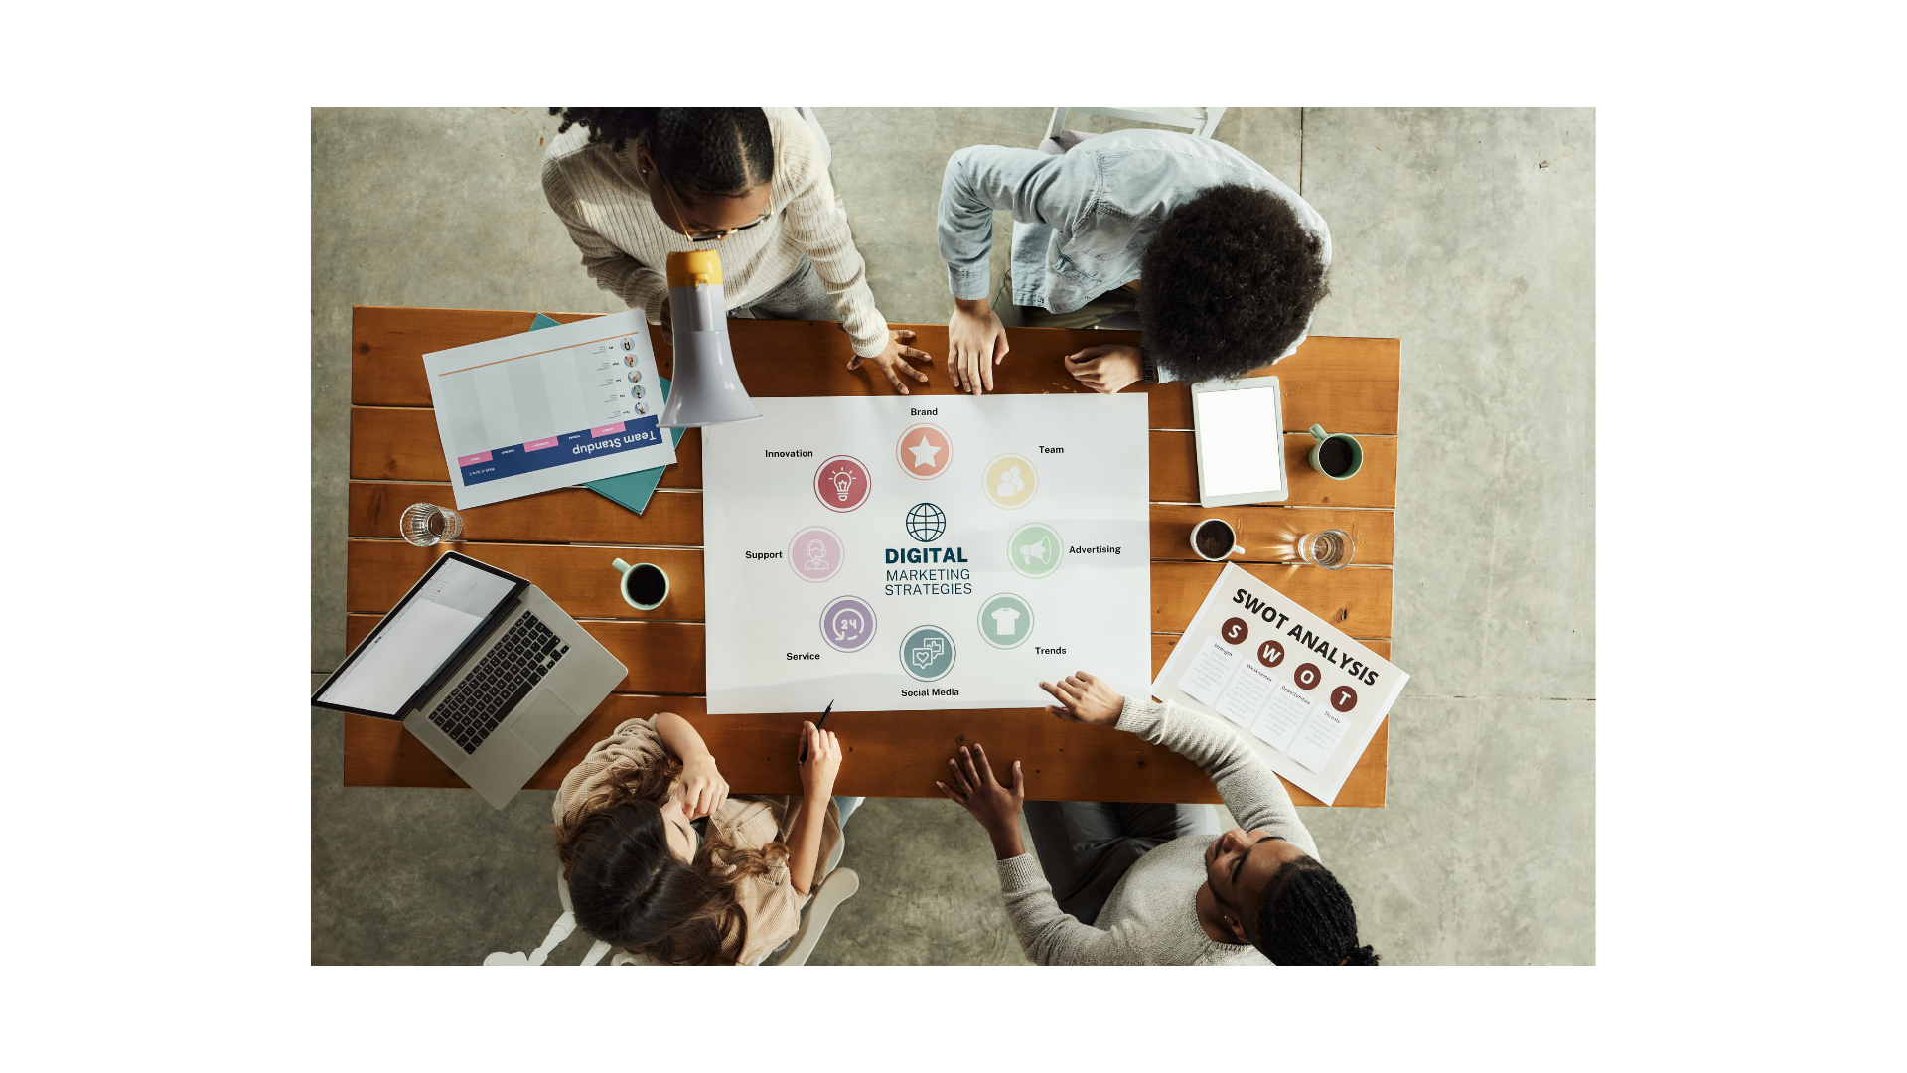
Part 4: Digital marketing strategy

Slide 11
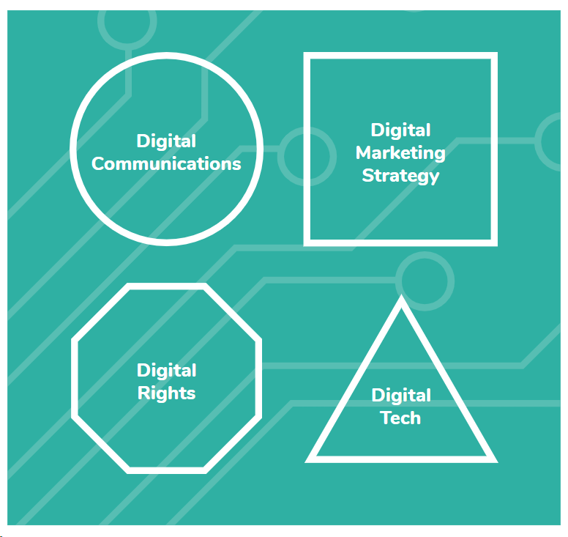


Four digital areas of improvement for the heritage sector

Slide 12
Digital marketing strategy
Key components of a digital marketing strategy include:
Knowing your vision and mission
Evaluating where you are currently
Knowing where you want to get
Measuring your success
Check the digital marketing strategy guide of Heritage Digital.
Notes:
Let’s recap on some key areas discussed in this session.
Why are digital skills important for GLAM?
What are some key digital competencies required when working in the GLAM sector?

Slide 13
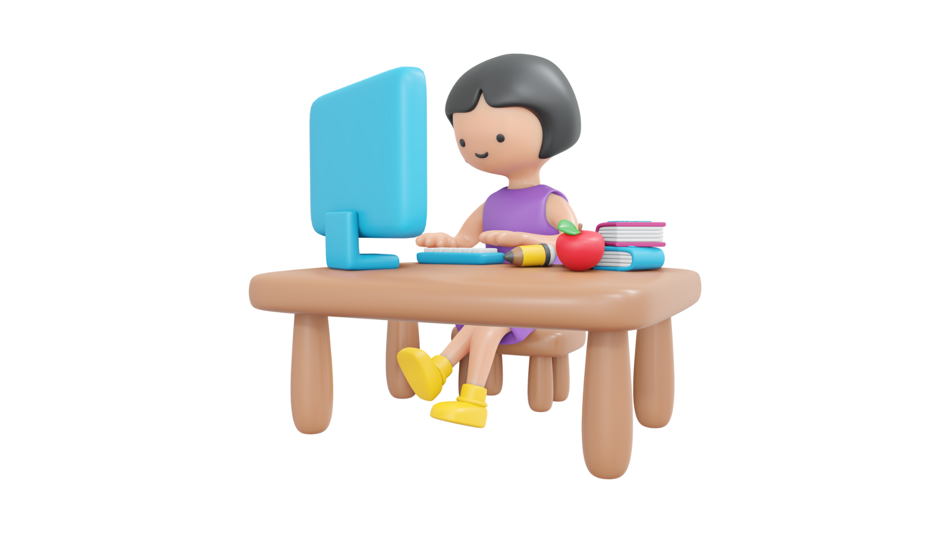
Self-reflection
What digital skills do you feel more confident in from the ones mentioned today?
What would you like to improve in?
Notes:
Let’s recap on some key areas discussed in this session.
Why are digital skills important for GLAM?
What are some key digital competencies required when working in the GLAM sector?

Slide 14
References
Blankenberg, Ngaire (2017) “Museum Organization for the Future” in Digital Museum Planning, ed. by A.
Hossaini, N. N. Bankenberg and G.Lord. p. 280–287. Lanham: Rowman & Littlefield. 391 pp.
Culture 24 (2020). The digital transformation agenda and GLAMs - Culture24 findings and outcomes, p. 14, 18.
https://pro.europeana.eu/files/Europeana_Professional/Publications/Digital%20transformation%20reports/The%20digital%20transformation%20agenda%20and%20GLAMs%20-%20Culture24,%20findings%20and%20outcomes.pdf
Museums Galleries Scotland (2021). “ The Digital Literacy for Leadership programme”
https://www.museumsgalleriesscotland.org.uk/project/the-digital-literacy-for-leadership-programme/
https://www.museumnext.com/digital-skills-for-museum-professionals/
Digital profiles/skills in Museums today_v3 https://cultura.gencat.cat/web/.content/dgpc/museus/06-actualitat/noticies/20201118_Digital-Profiles-Skills-in-Museums_v3_ConxaRod_2022.pdf
https://d13kjxnqnhcmn2.cloudfront.net/AcuCustom/Sitename/DAM/041/Heritage_Digital_Introduction_Guide.pdf
https://d13kjxnqnhcmn2.cloudfront.net/AcuCustom/Sitename/DAM/051/HD_DMS_guide_final.pdf

Slide 15

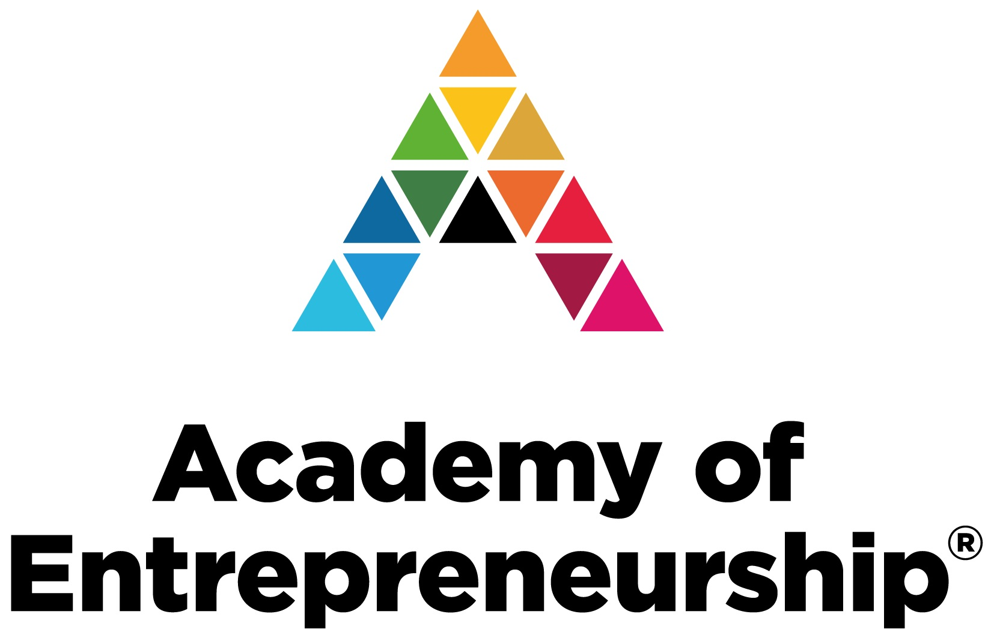

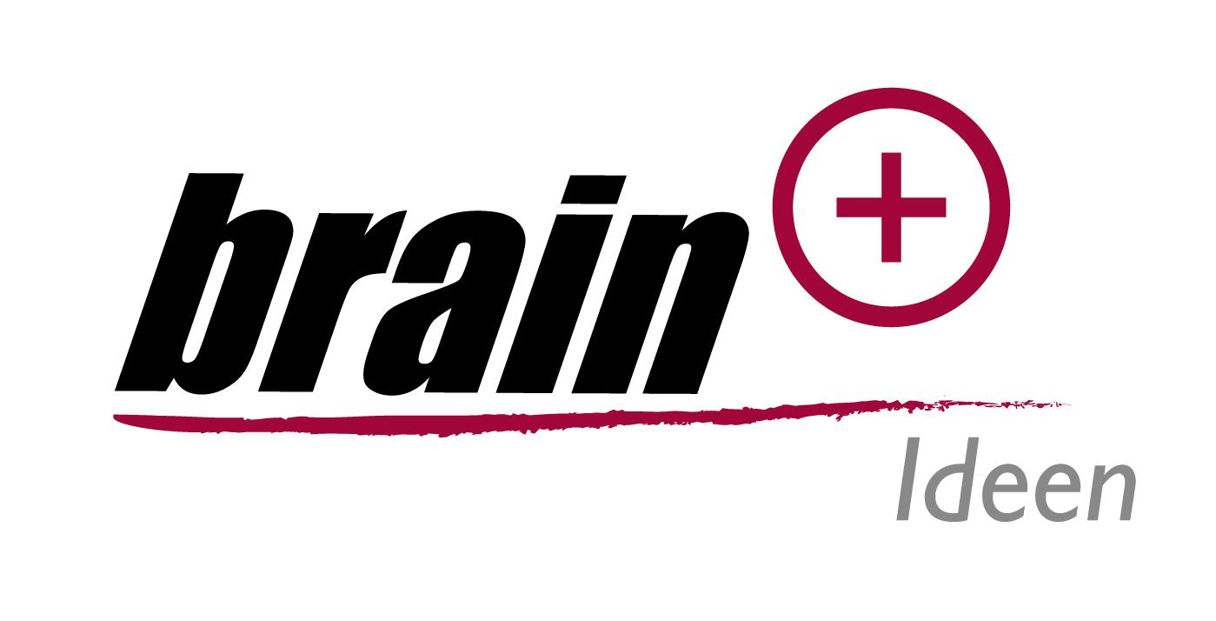

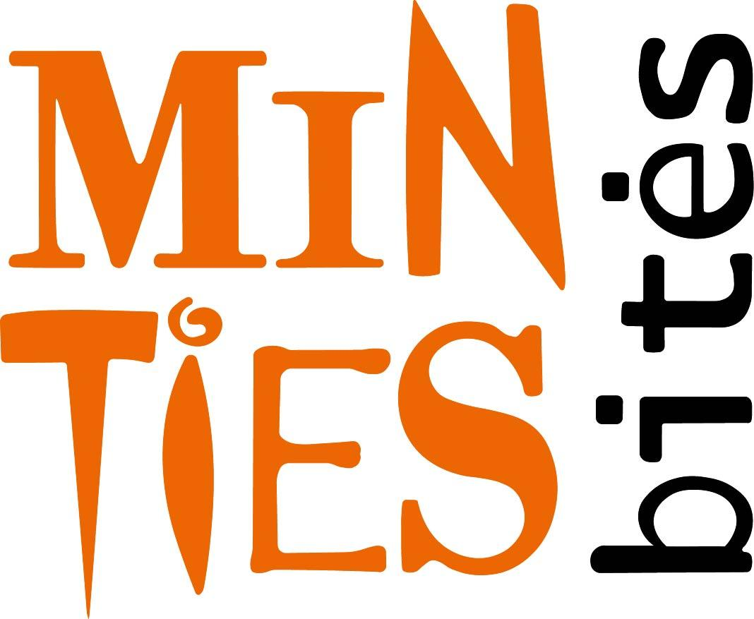
Promoting Inclusive Employment in the GLAM Sector through Open Innovation
Project No: 2022-1-AT01-KA220-ADU-00008513

